Slide 1


Slide 2
Clinical process indicators
Dr. Kęstutis Adamonis, Dr. Romanas Zykus,
2017 02 15 – 22
2017 03 09 – 15

Slide 3
Process evaluation
How a program works to achieve its goals and objectives
How well implementation goes
What difficulties exist.

Slide 4
Process evaluation
Documenting is essential for process evaluation
Process evaluation is most appropriate when your program is already being implemented or maintained, and you want to measure how well the program process is being conducted.
Process data often provide insight into why outcomes are not reached.
Answers the question: Do we fulfill what we promised to carry out

Slide 5
Clinical process indicators
Rate of complete colonoscopies (Cecal intubation rate)
Adenoma detection rate
Endoscopic complication rate (30-day colonoscopy specific mortality)

Slide 6
Clinical process indicators
The choice of indicators may depend in part on available resources for a given practice, but the ADR and cecal intubation rate appear to be the cornerstone elements
ADR remains the most reliable and best validated measure at this time, despite being somewhat burdensome to generate and not fully comprehensive.
It is also clear that no single indicator can fully evaluate all the complexities in quality of a colonoscopy, and it is likely that a truly comprehensive assessment requires the use of several indicators simultaneously.

Slide 7
Cecal intubation rate
Cecal intubation is achieved when the tip of the colonoscope is passed beyond the ileocecal valve lip, allowing effective visualization of the medial wall of the cecum lying proximal to the ileocecal valve.
This quality indicator has been proposed due to the well-known findings that a large portion of colorectal neoplasms is located in the proximal colon, including the cecum.

Slide 8
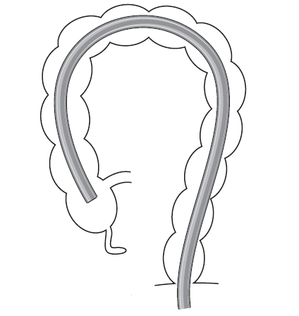
70 – 80 cm

Slide 10
Cecal intubation rates
Recommended benchmarks:
  90% for cecal intubation rates for all exams
  95% for screening exams.
When compared with patients whose exams were performed by endoscopists with a 80% completion rate, those whose exams were performed by endoscopists with higher completion rates had a lower risk for interval cancers.

Slide 11
Cecal Intubation > 95%
Cecal intubation rates have been associated with higher rates of interval proximal colon cancer.
Ceacal intubation rate correlated positively with adenoma detection rate (ADR).
Patient N with cecal intubation
Patient N with colonoscopy performed
CIR =
X 100

Slide 12
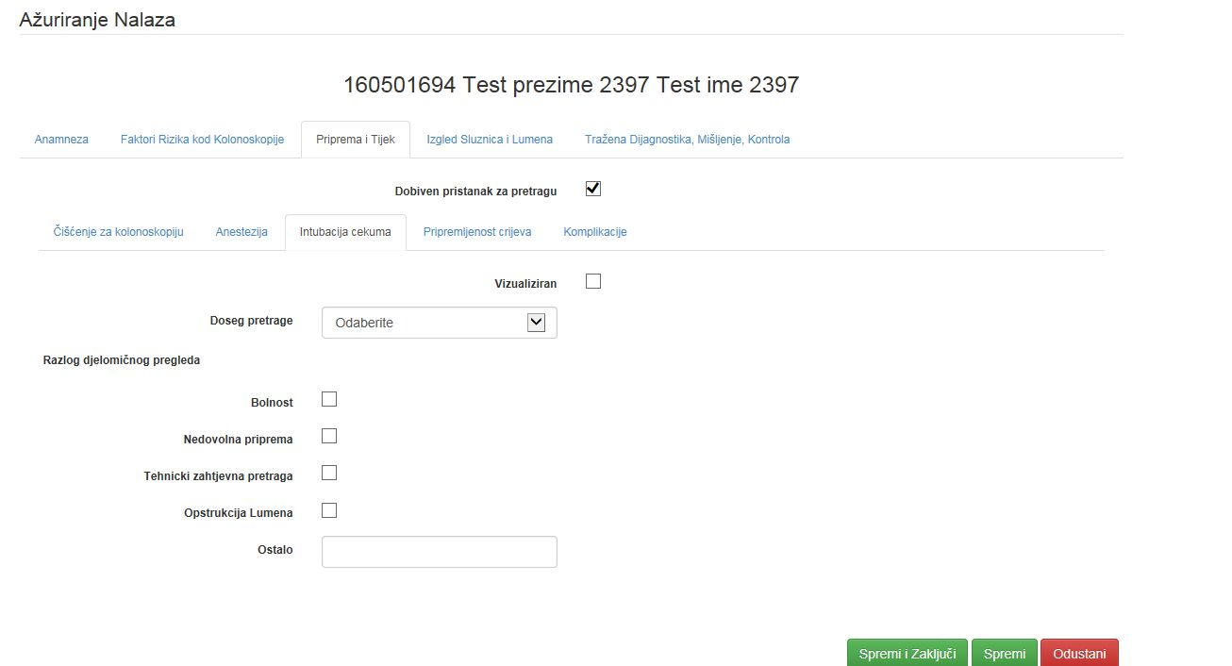

Slide 13
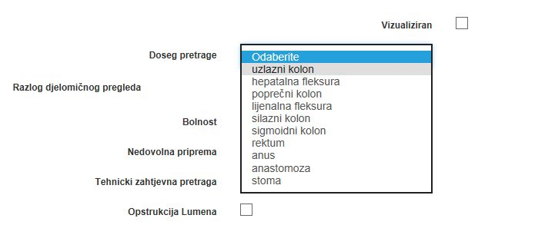

Slide 14
Cecal intubation rate
Documentation of reaching this landmark should be confirmed with photography of the cecal landmarks (i.e., appendiceal orifice and ileocecal valve).
Photo-documentation of the cecum is vital for subsequent physicians who may alter treatment or diagnosis if there is any doubt that a complete exam was performed.
It has been suggested that the optimal photograph should be taken distal enough from the cecum so that it contains an image of the appendiceal orifice with the ileocecal valve. An image of the ileum with villi may be helpful in confirming cecal intubation.

Slide 15
Adenoma detection rate
The adenoma detection rate (ADR) is the percentage of patients undergoing first-time screening colonoscopy who have one or more conventional adenomas detected and removed.
The ADR is clearly linked to the risk of interval CRC.
Cancer risk decreased linearly with increasing endoscopists ADR, overall and separately in the proximal colon and in the distal colon.

Slide 16
Adenoma detection rate
However, ADR is dependent on other quality measures, including cecal intubation rates, withdrawal times, and quality of bowel preparation.
Another concern with the use of ADR is that this measurement does not include the total number of adenomas detected.
A suggested new measure, called ADR-plus, is calculated as the mean number of additional adenomas, which were detected after the first lesion.

Slide 17
Adenoma detection rate
ADR is the quality indicator with the strongest association to post-colonoscopy CRC or “missed” CRC.
Adenoma Detection Rate: 25%
30% in men and 20% in women
ADR =
N people with at least one detected adenoma
N people with adequately tested with colonoscopy
x 100

Slide 18
Intervention associated with higher ADRs
Increase withdrawal time up to 8-10 minutes.
Get more “excellent” bowel preps by adjusting your bowel preparation protocol.
Retroflex in the cecum.
Publicly report mean ADR for group and privately report ADR for each individual endoscopist.

Slide 19
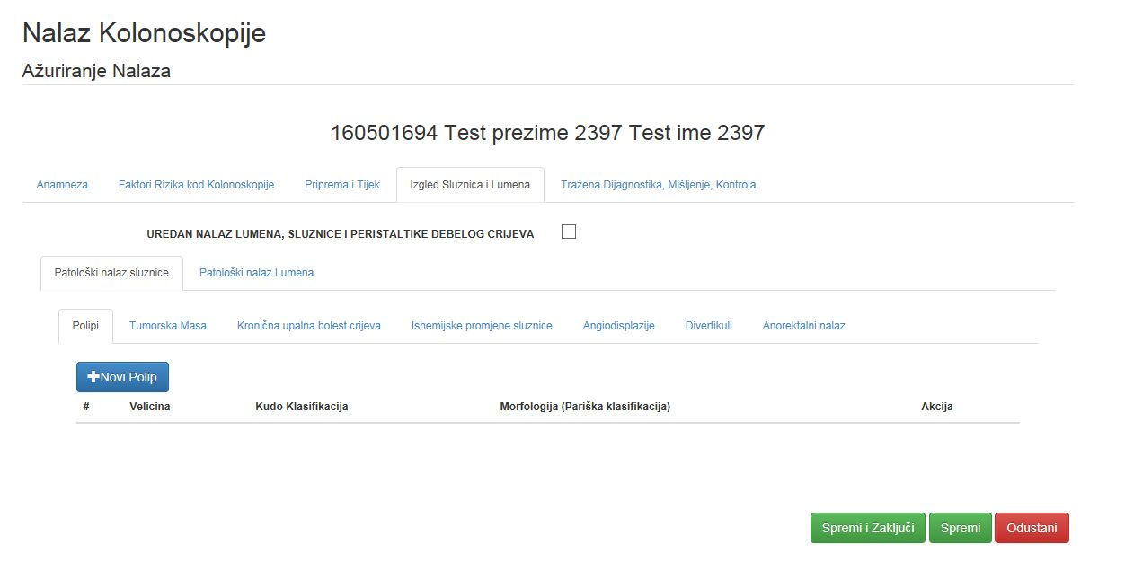

Slide 20
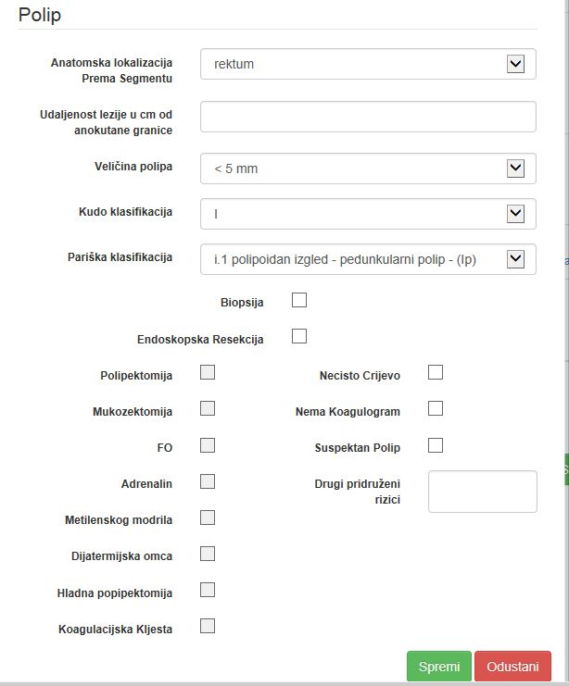

Slide 21
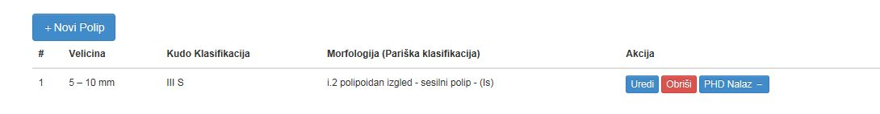

Slide 22
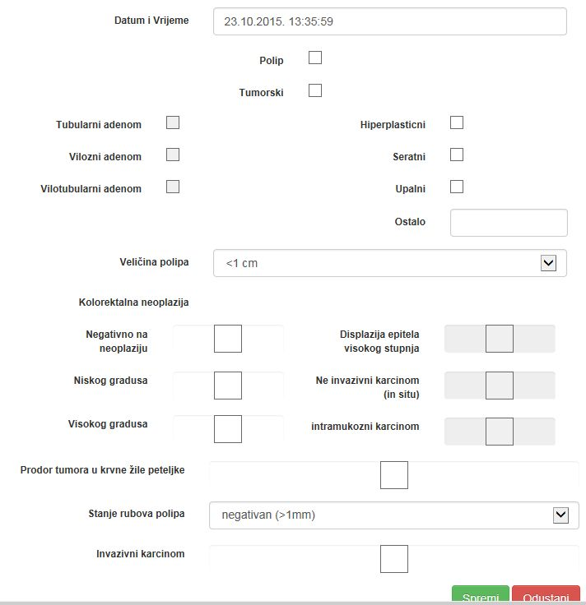

Slide 23
Endoscopic complications rate
It is defined as endoscopic complications that can appear in CRC screening programmes because of colonoscopy
The following complications are defined as serious:
  death within 30 days;
  hospitalisation within 30 days due to serious haemorrhage involving transfusion,
  due to perforation,
  vagal syndrome
  peritonitis-like syndrome.

Slide 24
Endoscopic complications rate
All complications should be recorded as well as the respective cause, if discernible.
For any complication the rate is defined as the proportion of participants presenting with a complication among those having attended endoscopic examination.
N people presenting with complication
of colonoscopy, respectively, during time frame
N people having attended the colonoscopy
during the time frame
ECR =

Slide 25
Expected complication rates
Three studies of colonoscopy screening have reported rates of severe complications of 0.0% to 0.3% (Lieberman et al. 2000; Schoenfeld et al. 2005; Regula et al. 2006).
Over 85% of the serious colonoscopy complications are reported in patients undergoing colonoscopy with polypectomy
Polypectomy was associated with a 7-fold increase in the risk of bleeding or perforation

Slide 26
Expected complication rates
Perforation: < 1 in 1,000
Post-polypectomy bleeding: < 1%

Slide 27
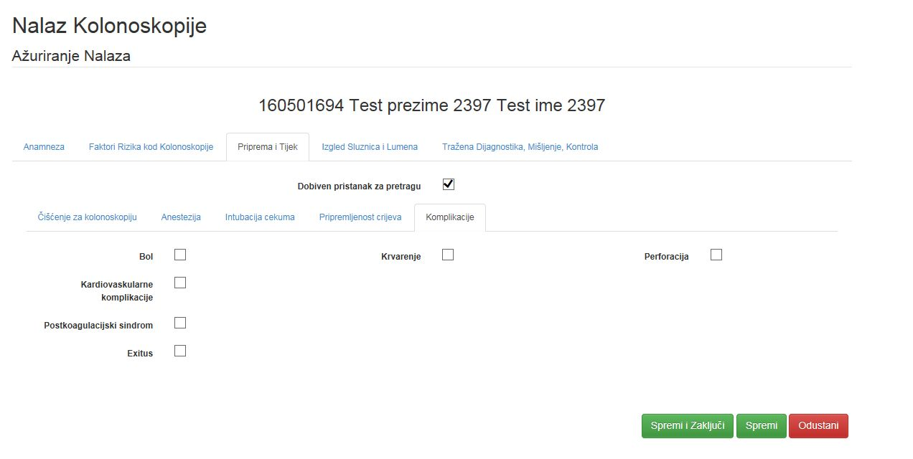

Slide 28
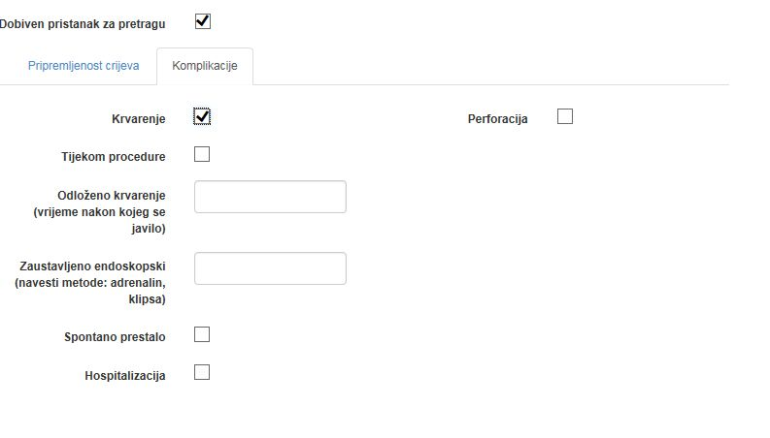

Slide 29
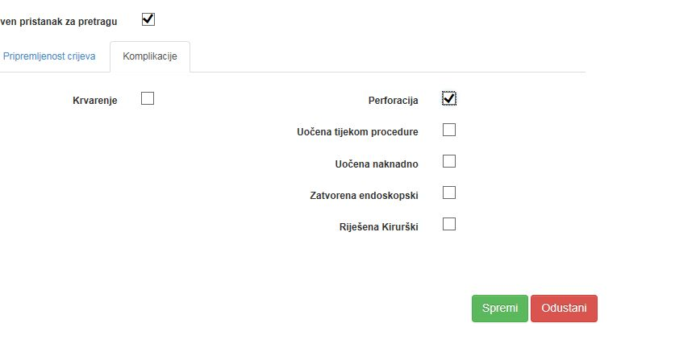

Slide 30
Workshop: Clinical process indicators
You are an expert of “National Committee for organization, expert monitoring, evaluation and quality control of the National colorectal cancer screening programme”. The program is going for almost 8 years and the long term impact indicator colorectal cancer related death is not decresing or decresing not enough during this period.

Slide 31
Discussion
What group of indicators should be checked for the reason of failure?
What results could show clinical process indicators?
Who is responsible for input of the data required for these clinical process indicators?
Is there any problem to monitor these indicators in Croatia? (At doctor, hospital, county and country level).
Who is most interested in gathering this data (medical workers, public health specialist, government or health system insurance?)
What materials and resources are needed to monitor all these indicators and to improve its collection?

