Slide 2
Overview of the performance indicators recommended by European guidelines for quality assurance in cervical cancer screening Dr. Rasa Vansevičiūtė, Lithuania
Twinning Project: Improvement of quality of the National Cancer Screening Programmes implementation (CRO SCREENING)

Slide 4
EVALUATION OF CANCER SCREENING
Evaluation of cancer screening programmes involves analyses of process and outcome.
Reduction in disease-specific mortality, being the primary purpose of screening, is the outcome of choice for studies of effectiveness.
Data must be made publicly available on a regular basis, i.e., annually, and over longer periods of time at the local/regional, national and European level.

Slide 5
INTRODUCTION
Cytological screening every three to five years can prevent up to four out of five cases of cervical cancer. Such benefits can only be achieved if screening is provided in organized, population-based programmes with quality assurance at all levels.
Quality assurance of the screening process requires a robust system of programme management and coordination, assuring that all aspects of the service are performing adequately.

Slide 7
SCREENING ORGANISATION, MONITORING AND EVALUATION (I)
The programme design must permit evaluation. An experimental design that is suitable for evaluation of new screening policies in organised settings is recommended.
The success of a screening programme requires adequate communication with women, health professionals and persons responsible for the health care system.
A well-organised screening programme must reach high population acceptance and coverage, and must ensure and demonstrate good quality at all levels.

Slide 8
SCREENING ORGANISATION, MONITORING AND EVALUATION (II)
Population-based information must be established for continuous monitoring of screening process indicators.
An appropriate legal framework is required for registration of individual data and linkage between population databases, screening files, and cancer/ mortality registers. Indicators of screening programme extension and quality need to be regularly published.
The information system is an essential tool for managing the screening programme; computing the indicators of attendance, compliance, quality and impact; and providing feedback to involve health professionals, stakeholders And health authorities.

Slide 9
HEALTH INFORMATION SYSTEMS AND REGISTRATION (I)
Population-based information system is the basic building block of organised screening programmes. The information system should be designed to support the screening programme and enable monitoring and evaluation.

Slide 10
HEALTH INFORMATION SYSTEMS AND REGISTRATION (II)
POPULATION-BASED INFORMATION SYSTEM SHOULD:
Identify the target population. For a screening programme, the database
incorporates the
entire target population;
Identify the
individual women in the
target population –
differentiating unscreened
and screened, and women
in specially targeted groups;

Slide 11
HEALTH INFORMATION SYSTEMS AND REGISTRATION (III)
Permit letters to be sent to the individual women in the target population to:
Invite or remind to attend for screening when a woman reaches the recommended age, and to re-attend for screening at the recommended interval, support early recall, if indicated.
Record the screening findings
and identify women for whom
further action is recommended.

Slide 12
HEALTH INFORMATION SYSTEMS AND REGISTRATION (IV)
Monitor that recommended action has been taken following the detection of an abnormality, and collect information on the further investigations and management
Provide long-term follow-up for patients who have received treatment
Identify cancers and deaths in the whole population
Permit linkage of individual screening episodes, and cancers and pre-cancerous lesions for systematic quality assurance purposes and feed-back to laboratories and clinicians.

Slide 14
MONITORING (I)
Monitoring is the process of continuous, ongoing evaluation to determine the quality of SCREENING steps and whether a programme is achieving intermediate objectives.
For this purpose, “process measures” are used. Of themselves these process measures are not indicators of the success of a screening programme. If comprehensive in scope they indicate, however, whether or not the programme is proceeding in a manner likely to achieve successful results, because such results are unlikely if performance targets are not met.

Slide 15
MONITORING (II)
The final objective of cervical screening is to reduce the incidence and mortality from cervical cancer, with the lowest burden and least adverse effects for women (human costs) and at the lowest economic cost.
Monitoring provides early feedback in order to identify problems and to make necessary changes.
Continuous and comprehensive monitoring systems that cover both organised and opportunistic screening are required.

Slide 16
MONITORING (III)
Guidelines presents standard tables that can be used for reporting the main characteristics of screening programmes and for computation of the performance indicators.
These tables should be considered template for standardised monitoring of screening performance in the EU.

Slide 18
MONITORING (IV)
Each member state should be able to fill in these or similar tables and make data available for inter-country comparison of basic performance indicators (recommended by the Council of the EU, 2003).
The current recommendation is that statistical reports should be produced and published at regular intervals, for a screening round of 3 or 5 years as well as annually.
Use of longer periods than a screening round are also recommended for the monitoring activity.

Slide 19
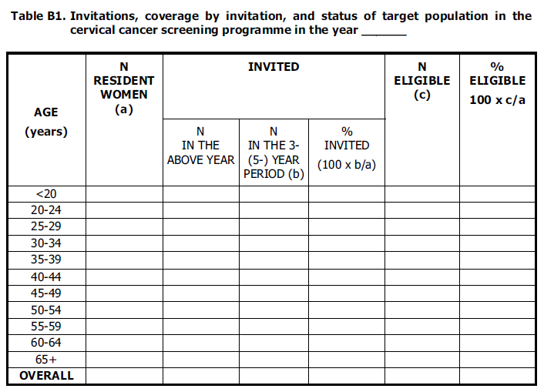

Slide 22
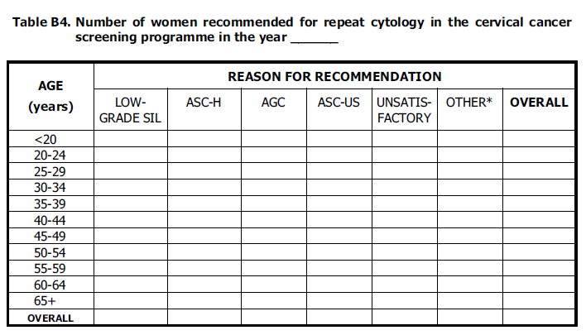

Slide 23
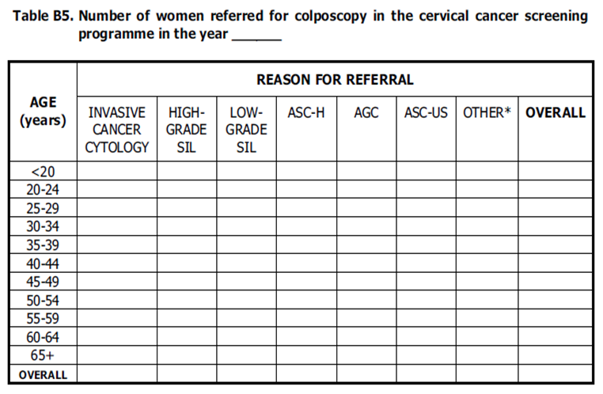

Slide 26
COST-EFFECTIVENESS (I)
Prior to the decision to initiate or change a screening programme, cost-effectiveness analyses should be carried out. To be comprehensive, the cost for the health system of each step of the programme and screening policy options should be evaluated:
invitations and attendance;
smear taking;
modifications of the screening test systems;
re-testing and follow-up procedures;
management strategies;
and documentation, registration, monitoring and evaluation.

Slide 27
COST-EFFECTIVENESS (II)
Computer simulation packages such as MISCAN, developed by the Erasmus University in Rotterdam (The Netherlands), and other modelling techniques based on Markov and Monte Carlo computer models have been employed in cost-effectiveness analysis.

Slide 28
KEY PERFORMANCE INDICATORS (I)
Key performance indicators is provided for monitoring the screening process and for identifying and reacting to potential problems at an early time.
The indicators address aspects of the screening process which influence the impact, as well as the human and financial costs of screening.

Slide 29
KEY PERFORMANCE INDICATORS (II)
Three groups of indicators can be distinguished:
Screening intensity. The proportion of the target population actually screened within the recommended interval is the main determinant of the success of a screening programme. Indicators include: programme extension, compliance with invitation, coverage, and smear consumption.
Screening test performance. Essential indicators include the referral rates for repeat cytology and for colposcopy, as well as the positive predictive value of referral for colposcopy, the specificity of the screening test, and the rate of detection of histologically confirmed CIN.
Diagnostic assessment and treatment. Indicators include compliance to referral for repeat cytology and for colposcopy; treatment of high-grade lesions is also an essential performance indicator. The proportion of women hysterectomised for CIN serves as an indicator of extreme over-treatment.

Slide 30
SCREENING INTENSITY INDICATORS (I)
SCREENING INTENSITY. THE PROPORTION OF THE TARGET POPULATION ACTUALLY SCREENED WITHIN THE RECOMMENDED INTERVAL IS THE MAIN DETERMINANT OF THE SUCCESS OF A SCREENING PROGRAMME.
INDICATORS INCLUDE: PROGRAMME EXTENSION, COMPLIANCE WITH INVITATION, COVERAGE, AND SMEAR CONSUMPTION.

Slide 31
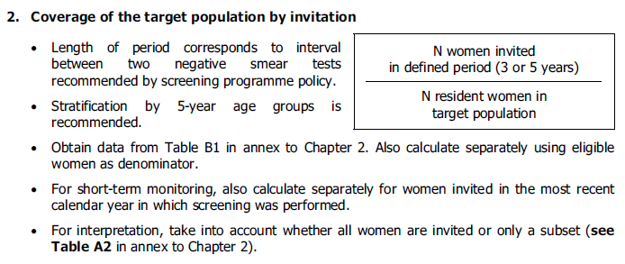
Screening intensity indicators (ii)

Slide 32
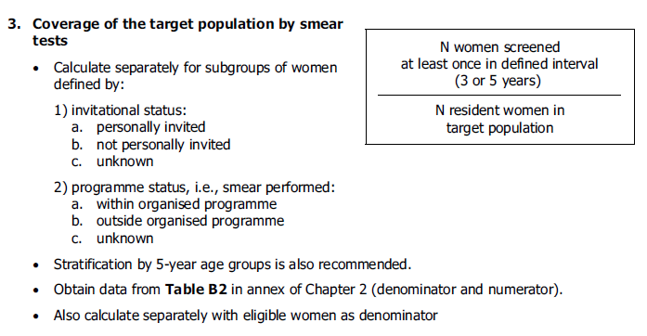
Screening intensity indicators (III)

Slide 34
Screening intensity indicators (IV)

Slide 35
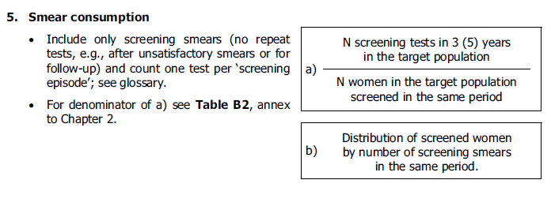
Screening intensity indicators (V)

Slide 36
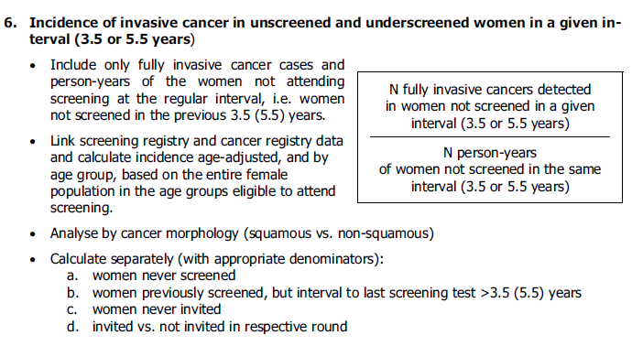
Screening intensity indicators (VI)

Slide 37
Screening test performance indicators (I)
Essential indicators include the referral rates for repeat cytology and for colposcopy, as well as the positive predictive value of referral for colposcopy, the specificity of the screening test, and the rate of detection of histologically confirmed CIN.

Slide 38
Screening test performance indicators (Ii)

Slide 39
Screening test performance indicators (iii)

Slide 40
Screening test performance indicators (iv)

Slide 41
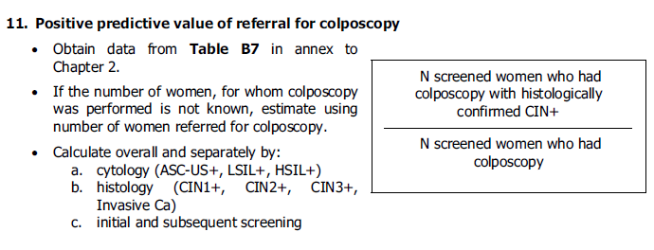
Screening test performance indicators (v)

Slide 42
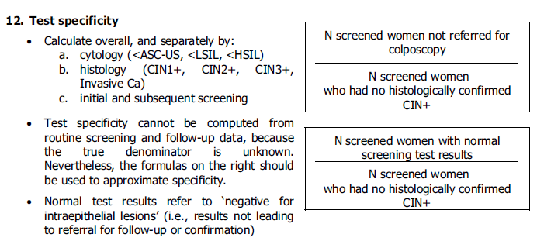
Screening test performance indicators (vi)

Slide 43
Screening test performance indicators (vii)

Slide 44
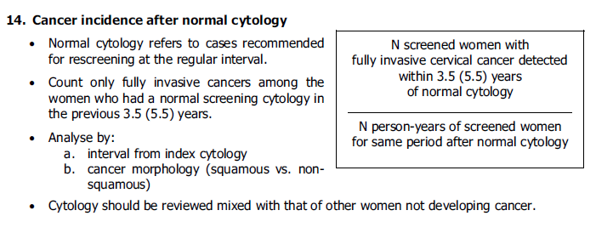
Screening test performance indicators (viii)

Slide 45
Reporting guidelines (I)
The screening programme managing institution has to check data entering quality and give instructions to improve data collection.
In defined time periods analytical data bases have to be prepared from the running information system.
Range of activity and quality indicators for each institution involved in screening services provision is monitored by using data entered into the centralised information system along with the activity performed.
Tables should present the participation in the programme, the main results of testing, and the main detection outcomes.
The results based on the collected data are presented and compared by population groups and geographic areas, and other characteristics.

Slide 46
Reporting guidelines (II)
Reports prepared by managing institution:
annually to the Croatian Health Insurance Fund and the Ministry of Health;
annually to National Committee for organisation, expert monitoring, evaluation and quality control of the NCSP or National steering board;
semi-annual and annual oral reporting to Programme board of experts;
semi-annual and annual reports to the County Public Health Institutes mainly on response rate in different regions with the aim of promoting and supporting communication activities;

Slide 47
Reporting guidelines (III)
performance indicators of each primary care team and personal lists of patients not responding to invitation, or not attending screening;
reporting to international organizations;
presentations at professional and other meetings;
information to public and media about programme results;
reporting within the Croatian Institute of Public Health.

Slide 51
INTRODUCTION (I)
Screening for cytological abnormalities and treatment of precursor lesions has contributed significantly to the substantial decline in cervical cancer incidence and mortality rates in Europe over recent decades.
Improvements in the control of cervical cancer have been particularly discernible in those countries which have implemented population-based screening programmes with high acceptance of personal invitation

Slide 52
SCREENING OUTCOME EVALUATION
The programme design should permit evaluation. One can distinguish between screening as a research exercise and screening as a public health policy.
The purpose of screening for cancer is to reduce disease-specific mortality. Therefore, the primary indicator of effect is the observed mortality compared with the expected mortality in the absence of screening.
For cervical cancer, the pre-invasive disease is detected by screening and therefore reduction in incidence of fully invasive cancer is also a valid indicator of effectiveness, in which case the condition being prevented by screening is future deaths

