Slide 2
Quality issues in monitoring diagnostic and treatment performance Dr. Rasa Vansevičiūtė, Lithuania
Twinning Project: Improvement of quality of the National Cancer Screening Programmes implementation (CRO SCREENING)

Slide 5
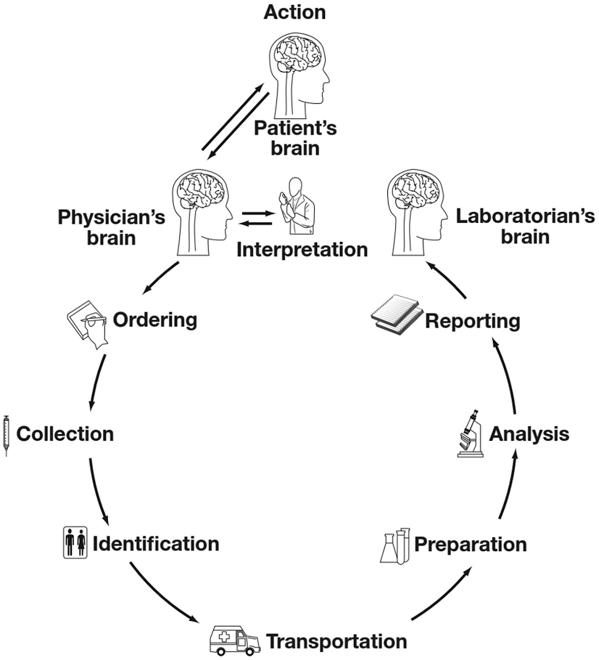
Quality issues in monitoring diagnostic and treatment performance

Slide 6
TEAMWORK

Slide 7
KEY PERFORMANCE INDICATORS
Key performance indicators is provided for monitoring the screening process and for identifying and reacting to potential problems at an early time.
The indicators address aspects of the screening process which influence the impact, as well as the human and financial costs of screening.
Three groups of indicators can be distinguished:
Screening intensity. The proportion of the target population actually screened within the recommended interval is the main determinant of the success of a screening programme. Indicators include: programme extension, compliance with invitation, coverage, and smear consumption.
Screening test performance. Essential indicators include the referral rates for repeat cytology and for colposcopy, as well as the positive predictive value of referral for colposcopy, the specificity of the screening test, and the rate of detection of histologically confirmed CIN.
DIAGNOSTIC ASSESSMENT AND TREATMENT. INDICATORS INCLUDE COMPLIANCE TO REFERRAL FOR REPEAT CYTOLOGY AND FOR COLPOSCOPY; TREATMENT OF HIGH-GRADE LESIONS IS ALSO AN ESSENTIAL PERFORMANCE INDICATOR. THE PROPORTION OF WOMEN HYSTERECTOMISED FOR CIN SERVES AS AN INDICATOR OF EXTREME OVER-TREATMENT.

Slide 8
Screening diagnostic assessment and treatment indicators
INDICATORS INCLUDE COMPLIANCE TO REFERRAL FOR REPEAT CYTOLOGY AND FOR COLPOSCOPY;
TREATMENT OF HIGH-GRADE LESIONS IS ALSO AN ESSENTIAL PERFORMANCE INDICATOR;
THE PROPORTION OF WOMEN HYSTERECTOMISED FOR CIN SERVES AS AN INDICATOR OF EXTREME OVER-TREATMENT.

Slide 9
Screening diagnostic assessment and treatment indicators

Slide 11
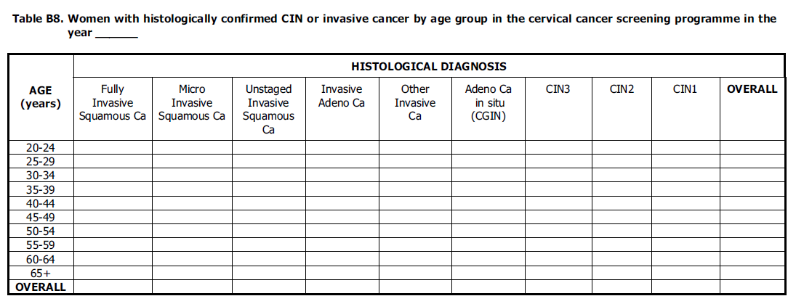

Slide 12
Screening diagnostic assessment and treatment indicators

Slide 14
Screening diagnostic assessment and treatment indicators

Slide 15
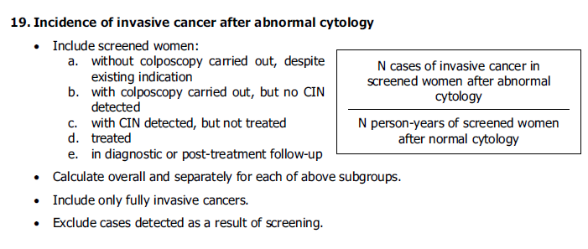
Screening diagnostic assessment and treatment indicators

Slide 16
Screening diagnostic assessment and treatment indicators

Slide 19
ONLY TOGETHER WE CAN

Slide 21
AUDITING SCREENING HISTORIES OF CANCER CASES (I)
WHEN SCREENING DATA CAN BE LINKED WITH THE CANCER REGISTRY, A COMPREHENSIVE EVALUATION WITH A SYSTEMATIC AUDIT PROCESS OF THE ENTIRE SCREENING PROGRAMME CAN BE PERFORMED.
EACH CASE OF CANCER SHOULD BE INVESTIGATED, I.E., CANCERS IN BOTH SCREENED AND UNSCREENED WOMEN. WHENEVER POSSIBLE, SCREEN-DETECTED CANCERS SHOULD BE DISTINGUISHED FROM SYMPTOMATIC CANCERS. AS THE EVOLUTION FROM A PRE-CANCEROUS LESION TO INVASIVE DISEASE USUALLY REQUIRES MUCH MORE THAN ONE SCREENING ROUND, THE REVIEW SHOULD INCLUDE NOT ONLY THE INTERVAL CANCERS BUT ALSO INVASIVE CANCERS THAT ARE DIAGNOSED AT SUBSEQUENT SCREENS. CIN3 CASES, IF DETECTED BETWEEN SCREENS, MAY ALSO BE USED IN AN AUDIT.

Slide 22
AUDITING SCREENING HISTORIES OF CANCER CASES (II)
IN CANCERS DIAGNOSED IN UNSCREENED WOMEN, INVITATION AND COMPLIANCE WITH INVITATION SHOULD BE EXAMINED. A SYSTEMATIC AUDIT WILL DISTINGUISH BETWEEN FAILURES IN INVITATION AND FAILURES IN COMPLIANCE WITH INVITATION. FEEDBACK ON THIS ISSUE IS PARTICULARLY INSTRUCTIVE FOR THE PERSONS IN CHARGE OF ORGANISING SCREENING.
REVIEW OF NEGATIVE CYTOLOGICAL SLIDES OF SUBSEQUENT CASES, SEEDED IN A RELEVANT SET OF CONTROL SLIDES AND INCLUDING BOTH BLINDED AND NON-BLINDED ASSESSMENTS, WILL ALLOW DISTINCTION BETWEEN: ERRORS IN CYTOLOGICAL INTERPRETATION (OBVIOUS HUMAN ERRORS OR SLIDES CONTAINING VERY FEW ABNORMALITIES),
PROBLEMS ATTRIBUTABLE TO SAMPLE QUALITY, AND DIFFICULTIES IN DEVELOPMENT OF DIAGNOSTIC CRITERIA. THIS RE-READING SHOULD INVOLVE BOTH THE ORIGINAL AND AN EXTERNAL (REFERENCE) LABORATORY.

Slide 23
AUDITING SCREENING HISTORIES OF CANCER CASES (III)
REGISTRY-BASED AUDIT SHOULD BE CARRIED OUT FOR ANY SCREENING TECHNOLOGIES THAT ARE IMPLEMENTED IN THE PROGRAMME.
TO STUDY SPECIFICITY CRITERIA, SAMPLES OF FALSE POSITIVE TESTS CAN ALSO BE INCLUDED IN AN AUDIT. SYSTEMATIC AUDITS SHOULD ALSO EXAMINE COLPOSCOPY MANAGEMENT, HISTOLOGICAL DIAGNOSIS, AND ADEQUACY OF TREATMENT AND FOLLOW-UP OF PRE-CANCEROUS LESIONS. AUDITS SHOULD ALSO ASSESS COMPLIANCE WITH RECOMMENDATIONS FOR REPEAT SMEARS AND COLPOSCOPY AND SHOULD DETERMINE WHETHER THOSE RECOMMENDATIONS WERE APPROPRIATE.

Slide 24
AUDITING SCREENING HISTORIES OF CANCER CASES (IV)
CASES SHOULD BE DISCUSSED IN A MULTI-DISCIPLINARY FORUM SO THAT FACTORS THAT RESULTED IN CANCERS NOT BEING PREVENTED CAN BE PUT IN THE CONTEXT OF OTHER FACTORS, STAGE OF CANCER AND WHETHER OR NOT THE CANCER WAS SCREEN-DETECTED (SCREEN-DETECTED CANCERS ALSO INCLUDE THOSE DETECTED IN A FOLLOW-UP PROCESS).
Feedback of the results of such systematic audits to the concerned health professionals is very instructive, but must be done with caution, respecting local rules.

Slide 25
AUDITING SCREENING HISTORIES OF CANCER CASES (V)
An important element of the audit is to follow and monitor the laboratories over the long term, to demonstrate whether the quality assurance activity contributed to any additional effectiveness, and to identify key barriers.
It is important to verify whether the sensitivity improved without losing a good level of specificity, and to monitor the treatment rates to check for over-diagnosis.
Checking and improving register data quality is also a task within the audit.

Slide 26
ONLY TOGETHER WE CAN !!!

Slide 27
THANK YOU VERY MUCH !!!

