Slide 1


Slide 2






Number of women referred for further investigation in relation to all imaged women – recall rate
Dr. Ruta Briediene, Dr. Ruta Grigiene,
Dr. Laima Grinyte, Dr. Egle Jonaitiene
2016 10 24-28

Slide 3
Recall Rate Is Influenced By :
Mammographic thechnologies available
    Screen-film mammography (SFM)
    Full field digital mammography (FFDM)
Human pysical parameters
    Breast reader‘s expertise and
    work experience
Woman‘s presentation
    Woman‘s age
    Screening history
    Use of hormone therapy
    Breast density
    Previuos invasive procedure
    Familial breast cancer

Slide 4
Recall Rate And Imaging Technologies
Digital mammography
  Improved image receptor systems
    More consistent image quality
    Higher contrast resolution
    Fewer artifacts
    Lower radiation dose
  Post processing capabilities
    Improved cancer detection (especially in dense breast)
    Not necessity repeate under-exposed or over-exposed images
      Resulting in a lower recall rate
    Worse spatial resolution is adjusted by altering the image contrast, windowing, magnification

Slide 5
Recall Rate And Imaging Technologies
Digital mammography
  Advantage for specific cohorts of women
    under the age of 50 y,
    dense breast,
    premenopausal
  Some limitations
    Workstation designs
    Unfamiliarity of the readers with reading digital cases
    Readers with experience in reading SFM perform higher for specifity
      0.83 versus 0.70; p < 0.001 (Rawashdeh et al. SPIE; 2015)

Slide 6
Recall Rate And Differencies In Practice
Reader background
    Radiologists (most countries)
    Radiographers (United Kingdom)
    Breast physicians (Australia)
Dedicated education in mammography
    Fellowship training system – breast radiologist
      Reduce false positive recall rates
      Early meet an acceptable standard of national performance
      Faster learning curve
    Continuing professional development
    Feedback programmes for readers
      Personal Performance in Mmographic Screenint (PERFORMS), UK
      BreastScreen Reader Assessment Strategy (BREAST), Australia
    Attendance of multidisciplinary breast cancer team meetings

Slide 7
Recall Rate And Differencies In Practice
Reader‘s characteristics and work practices
    Experience (years in interpreting mammograms)
      Work faster
      Interpret more accurately
      Less false positives and false negatives
    Reading volume
      Better knowledge bank of normal presentation
      More certainty of benign findings
      Better identification of range of cancers presentation
      Lower false positives
      Lower recall rate
      Better Cancer detection rate
Notes:
Experienced readers have reducedd fals positives rates in screening mammography, they read an interpret images faster and can identify lesions more accurately.

Slide 8
Recall Rate And Differencies In Practice
Minimum annual volumes
    960 cases during 24 mo – United States
    2000 / y - Australia
    5000 / y – UK
    Significant correlation between CDR and volume of cases (P < 0.03) with higher specifity
        Reed et all. Acad Radiol, 2010
        Rawashdeh et al. SPIE; 2015
  Large and regular volumes of screening cases appears vital to produce higher performance and lower recall rates

Slide 9
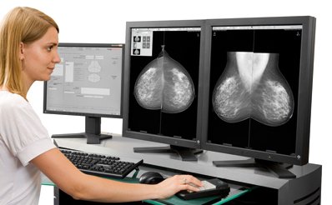
Reader‘s characteristics and work practices
Mammography assessment deviations from real diagnosis
Readers No 4,5,7,8:
involved in breast unit work,
skills in multimodality breast diagnostics
big annual reading volume (> 4000)
E Jonaitiene / Radiography xxx (2010) 1e8
(distribution of mean squares of deviations)

Slide 10
Correlation between diagnostics accuracy and radiologists proficiency
Experience of Readers | Agreement with diagnosis |  | Accuracy |  | Sensitivity |  | PPV
 | r | p | r | p | r | p | r | p
Experience in MG reading | 0.529 | 0.095 | 0.351 | 0.290 | 0.397 | 0.227 | 0.472 | 0.143
Reading volume (MG/year) | 0.727 | 0.011 | 0.62 | 0.044 | 0.466 | 0.249 | 0.663 | 0.026
Skills in breast examinations | 0.763 | 0.006 | 0.71 | 0.015 | 0.444 | 0.172 | 0.785 | 0.004
Work in breast unit | 0.87 | 0.000 | 0.84 | 0.01 | 0.9 | 0.793 | 0.64 | 0,035
r – Spearman‘s correlation coeficient.
Significant dependance on beeing involved in comprehensive breast centre (breast unit) work, skills in multimodality breast diagnostics and annual reading volume

Slide 11
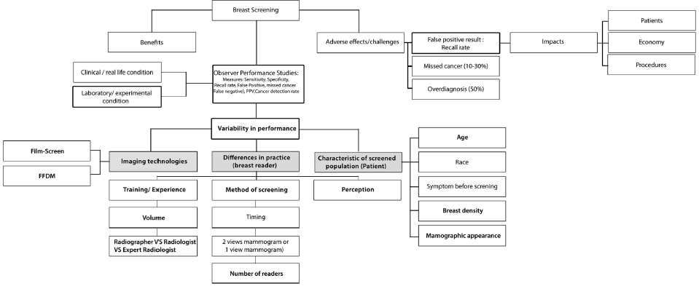
Factors that contribute to a false positive-recalled decision outcome
N. Mohd Norsuddin et al. / Radiography xxx (2015) 1e8

Slide 12
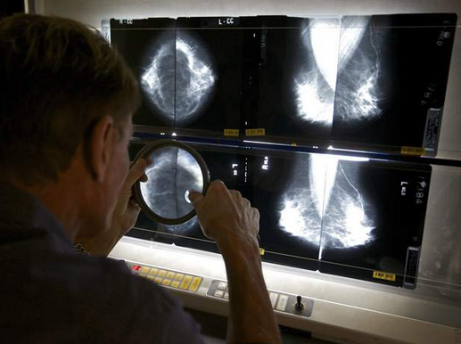
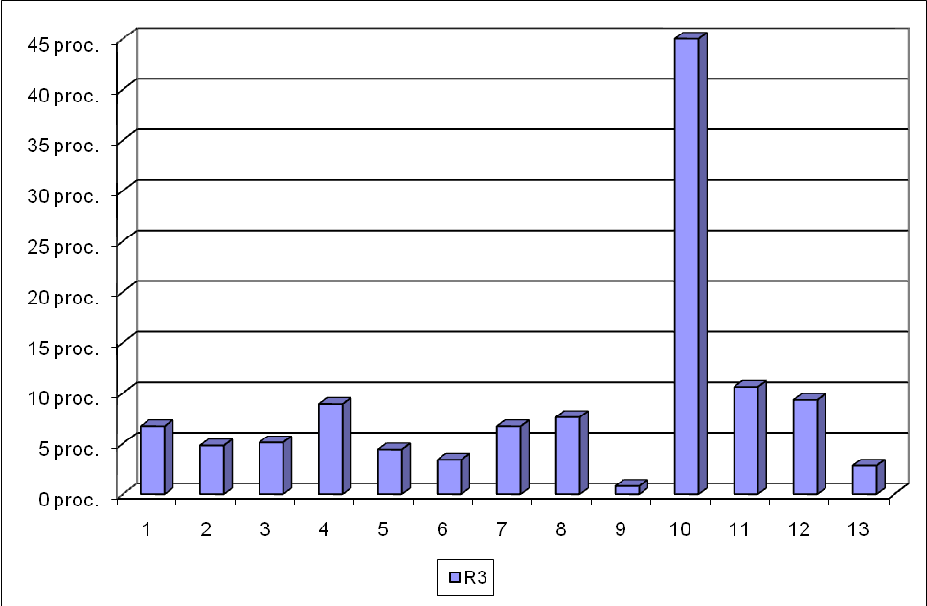
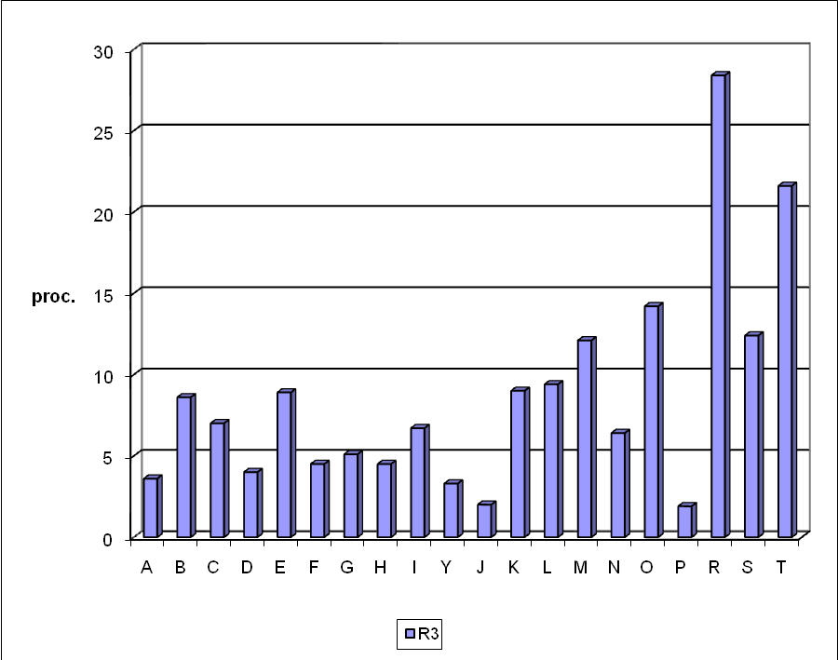
Incidence of possible beningn findings in different Screening Units in Linthuania (2006 and 2009)
2006
Change of radiogists
2009
A‒T ‒ Screening Units: A‒L – since 2005, M‒T ‒ since 2009

Slide 13
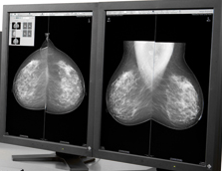
Recall rates and Reader work practices (logistics)
Single-reading
Double interpretation
  Improves CDR
  Without an increase in the recall rates

Slide 14
Recall rates and the characteristics of the screened population
Physical and social
  Age
  Physical breast density
  Use of hormonal replacement therapy
  Familial history of breast cancer
Radiological/history
  Optical/mammographic density
  Time between screenings
  Previous mammograms
Individual patient‘s
  Previous breast surgery/biopsies
  Family history of breast cancer
  Previous mammograms

Slide 15


Recall rates and cancer detection rates
How recall rates alter in relation in CDR is not well understood and the relationship between sensitivity and recall rate is not necessary linear.
Some studies arguments:
An increased increment in recall rate could improve the CDR due to earlier detection of interval cancers.
Increasing recall rate simply increases false-positive recalls

Slide 16
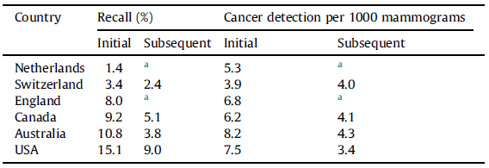
International comparison result of recall rates and cancer detection rates
No significant increase in the cancer detection rate
and substantional increase of the recall rate
Yankaskas BC et al. J Med Screen 2004;11(4):187e93
Australian Institute of Health and Welfare. Breast Screen Australia monitoring report 2010e2011. 2013.
Notes:
In some countries very limited recals but a posspible trade-of for cancer detection. The United states have much higher reall rates and this may reflect a medical and screening enviroment where ligitation ar common adn feared.

Slide 17
International data and interventions to reduce the recall rates
Countries | Recall rates
 | First screening | Subsequent screening
European countries (average of nations with published data) | 7% | 5%
Australia | 10% | 5%
European Guidelines | 5% | 3%
Control of mammographic performance quality
  Mammography Quality Standards Act (MQSA) in USA
  BreastScreen Australia National Accreditation Standard (NAS)
Research on effect of enforcing target recall rates on the reader’s performance
Determination of optimal, international applicable target recall rates
Notes:
The recommended target recall rates across Australian and European porgrammes varies significantly in their breast screening classification.
However some European nations (Netherlands, Switzerland) have recall rates lower than the standard recommendations in European Guidelines.
Control over the variability of mammographic performance quality and the effectiveness of mammography programmes have been addressed through the regulation of mammography facilities .
Health professionals should be aware of their own countries recall rates in relation to others as a catalyst for discussing optimized recall rates for the population screened.
Recall rates and false positive decisions, that result in additional imaging and over diagnosis, continue to be a strong concern for women participating in screening mammography programmes and hence research in this field is timely

