Slide 1


Slide 2

CRO SCREENING
Twinning project activities and results in the 1st reporting period
(2 March 2016 – 31 May 2016)
Prof. dr. Giedrius Vanagas
Resident Twinning Adviser (RTA)

Slide 3

Activities in the reporting period
Preparation activities: 6 Missions, 11 working days;
RTA arrival: 1 April, 2016
Kick-off: 29 April, 2016 - 2 Missions, total 3 working days;
17 STE missions, total 76.5 working days.
3 Side Letters and 1 Operative Side letter have been issued.

Slide 4
Activities in the reporting period
17 STE missions, total 76.5 working days.

Slide 5
Achievement of mandatory results
We have started activities in 4/5 components;
  Fully achieved mandatory results in 4 activities;
  1 activity just started;
Visibility ensured on Kick-off event;
Project Leaflets and press release produced.
Notes:
National Breast Cancer Screening Programme was introduced in 2006. The target group of National Breast Cancer Screening Programme are women aged 50-69 with a screening interval of 2 years. So far three cycles were completed (invitations were sent out and screenings conducted). The response for the first cycle was 63%, for the second cycle 57% and for the third cycle 60% (three counties had 70% response). In May 2014 the fourth cycle has begun and is on-going.
National Colorectal Cancer Screening Programme has been implemented since 2008. The target group of the National Colorectal Cancer Screening Programme is population aged 50-74 with the screening interval of 2-3 years. By the end of 2012, the first cycle was completed with the response of 21%. The second cycle started in November 2013 and is currently on-going.
National Cervical Cancer Screening Programme began with implementation in December 2012 and is currently on-going. The target group are women aged 25-64 with screening interval of 3 years. The second cycle is envisaged to start in first quarter of 2016.

Slide 6
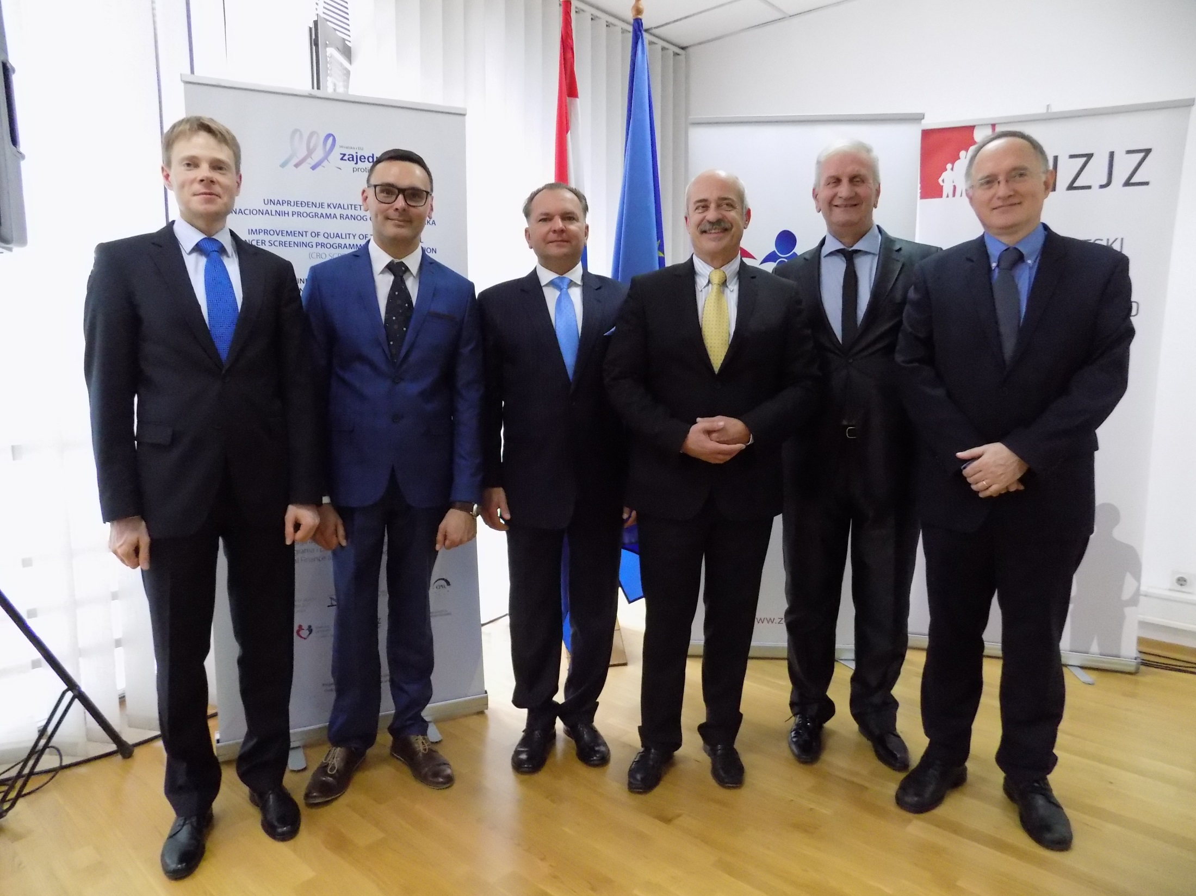

Slide 7
Achievement of mandatory results
Component 0: Project Visibility
Activity 0.1:
Kick off meeting implemented | 100% fulfilled | Completed. Kick-off held on 29 April 2016 with Project Leaflets and press release produced
Results and indicators | (% of achievement) |  | State of achievement/ problems encountered
Notes:
Meeting was successfully organised and held. Leaflets with information about the Twinning project were printed and disseminated. Press release published and visibility of the project achieved. In order to guarantee more visibility a website (www.croscreening.hzjz.hr) will be designed. A constant updating of the contents of the twinning website will ensure wide visibility to the activities carried out and the results achieved.

Slide 8
Achievement of mandatory results
Component 1: Organization and implementation of the National Breast Cancer Screening Programme on national and regional level improved
Activity 1.1
Conducting analysis of the legislative and institutional framework of the National Breast Cancer Screening Programme and preparing analysis report with recommendations for improvement | 100 % fulfilled | Completed. Prepared analysis report of the legislative and institutional framework of the National Breast Cancer Screening Programme with recommendations for improvement.
Results and indicators | (% of achievement) |  | State of achievement/ problems encountered

Slide 9
Achievement of mandatory results
Component 2: Organization and implementation of the National Cervical Cancer Screening Programme on national and regional level improved
Activity 2.1
Analysis of the legislative and institutional framework of the National Cervical Cancer Screening Programme conducted and analysis report with recommendations for improvement prepared. | 100 % fulfilled | Completed. Prepared analysis report of the legislative and institutional framework of the National Cervical Cancer Screening Programme with recommendations for improvement.
Results and indicators | (% of achievement) |  | State of achievement/ problems encountered

Slide 10
Achievement of mandatory results
Component 3: Organization and implementation of the National Colorectal Cancer Screening Programme on national and regional level improved
Activity 3.1
Analysis of the legislative and institutional framework of the National Colorectal Cancer Screening Programme conducted and analysis report with recommendations for improvement prepared | 100% fulfilled | Completed. Prepared analysis report of the legislative and institutional framework of the National Colorectal Cancer Screening Programme conducted with recommendations for improvement.
Results and indicators | (% of achievement) |  | State of achievement/ problems encountered

Slide 11
Achievement of mandatory results
Component 5: Monitoring and reporting of the National Cancer Screening Programmes on national and regional level improved.
Activity 5.4
Functional and technical specifications for upgrading of the Screening Register prepared | 100 % fulfilled | Completed. Functional and technical specifications for upgrading of the Screening Register prepared
Results and indicators | (% of achievement) |  | State of achievement/ problems encountered

Slide 12
Achievement of mandatory results
Component 5: Monitoring and reporting of the National Cancer Screening Programmes on national and regional level improved.
Activity 5.5
Screening Register upgraded | 5 % fulfilled | Started. The documentation for public procurement prepared and procurement procedures for the registry upgrade has been launched.
Results and indicators | (% of achievement) |  | State of achievement/ problems encountered

Slide 13
Adherence to time schedule
Activities | Months
 | April | May | June | July | August | September
0.1
0.2
1.1
1.2
1.3
1.4
2.1
2.2
2.3
2.4
3.1
3.2
3.3
3.4
4.1
4.2
4.3
4.4
4.5
4.6
4.7
5.1
5.2
5.3
5.4
5.5

Slide 14
Future activities
2 quarter:
  1.2; 2.2 and 3.2 Missions (7-10 June 2016);
  5.5 Mission (27 June – 1 July 2016);
  1.3; 2.3 and 3.3 Missions (28 June – 1 July 2016);
  1.4; 2.4 and 3.4 Missions (4-8 July 2016).
  Total: 16 Missions, 68 expert days

Slide 15
Future activities
3 quarter:
  4.1 Mission (29 August– 2 Sept, 2016);
  5.1 Mission (5-9 Sept, 2016);
  4.6 Mission (19-23 Sept, 2016);
  4.2 Mission (3-7 Oct, 2016);
  5.2 Mission (10-14 Oct, 2016);
  4.4 Mission (24-28 Oct, 2016);
  5.3 Mission (7-11 and 14-18 Nov, 2016);
  4.7 Mission (23-25 Nov, 2016)
  Total: 33 Missions, 157 expert days

Slide 16
Overall assessment of progress
17 STE missions, total 76.5 working days.
3 Side Letters and 1 Operative Side letter have been issued.
Good and efficient collaboration with HZJZ and MoH staff in preparation of STE missions round table;
Added value: as a result of previous missions, we initiated the signing of the Declaration by main stakeholders on improvement of Cancer screening programmes;
Daily and timely technical support from CFCA;
Aiming to fully implement 1-2-3 components on 8th July (achievement: 50% of project mandatory results).

Slide 17
Issues and problems
Technical delays to start the project required large adjustments in dates of implementation and this was followed by needs to replace experts due to their unavailability on newly defined dates. As a result, we issued 3 side letters (2 on expert change).
Summer time (and the upcomming vacation period) makes it impossible to plan missions.

Slide 18
Risk management issues
Risk | Management actions should be taken
Availability of the BC and MS experts is not ensured. | The planing of mission dates in advance (2-3 monts before mission). BC and MS PL should be taking responsibility to ensure availability of experts.
Relevant stakeholders do not succeed to ensure the active participation in the planned activities; | The planning of mission dates in advance should ensure timely invitations and replacements if necessary.
Adequate experts are not available for the trainings and workshops; | Invitations and information to the participants has to be sent far in advance. We already asked BC to prepare lists of participants and define target groups for trainings in component 4.
The necessary information, data or documents are not available or not provided on time; | We do planning of mission dates in advance. We implement daily meetings with BC counterpart to discuss availability and timely provision.
The contract not signed or outputs from the private sector contract are not delivered or of sufficient quality; | The contracting should be implemented according to Lithuanian Law on Procurement and it is out of our control. To ensure quality of output it is planned to have expert missions.

Slide 19
Next PSC meeting
Date proposal:
27 September 2016

Slide 20

Resident Twinning Adviser (RTA):
Prof. Giedrius Vanagas (LUHS)
T. +380-1-4863371 mob. +385-95-7309806 giedrius.vanagas@hzjz.hr

