Slide 1


Slide 2

CRO SCREENING
Twinning project activities and results in the 2nd reporting period
(1 June 2016 – 31 August 2016)
Prof. dr. Giedrius Vanagas
Resident Twinning Adviser (RTA)

Slide 3

Activities in the reporting period
22 STE missions, total 98 working days.
1 Addendum on BC PL change has been issued.
1 Operative Side letter have been issued.
1 Side Letter

Slide 4
Activities in the reporting period
22 STE missions, total 98 working days.

Slide 5
Achievement of mandatory results
We have started activities in 4/5 components;
  In this reporting period fully achieved mandatory results in 10 activities;
    3 Reports with recommendations on improvement
    3 Round tables with stackeholders
    Guidelines for breast, cervical and colorectal NSP
    Technical specifications for registry upgrade
  2 activities implemented in September
  1 activity just started this week;

Slide 6
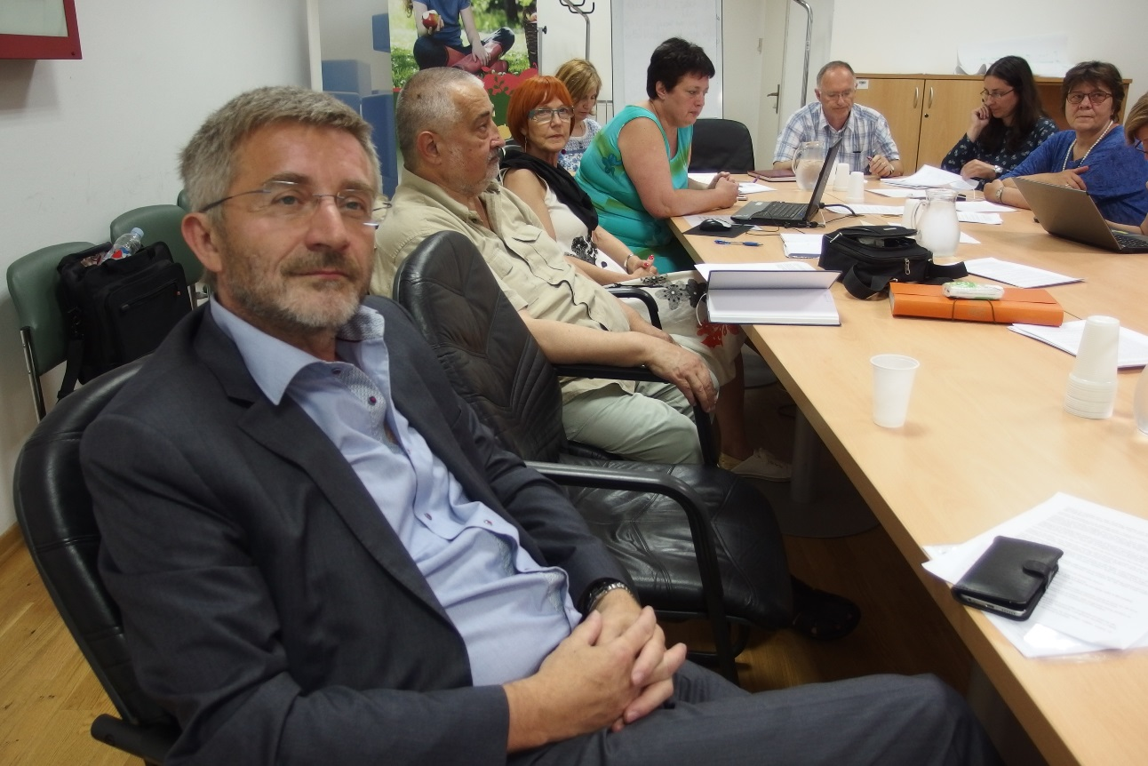
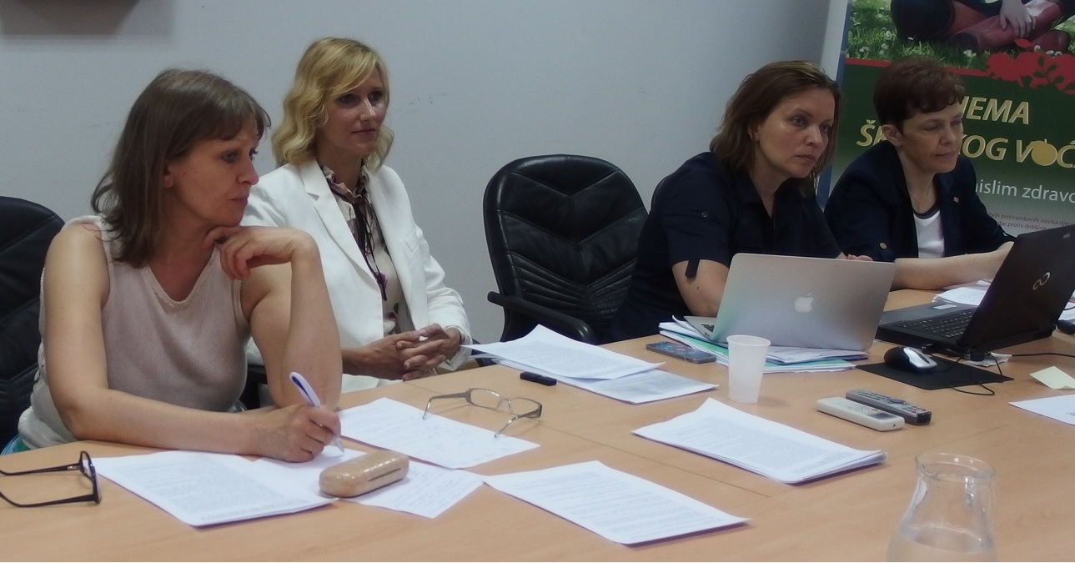
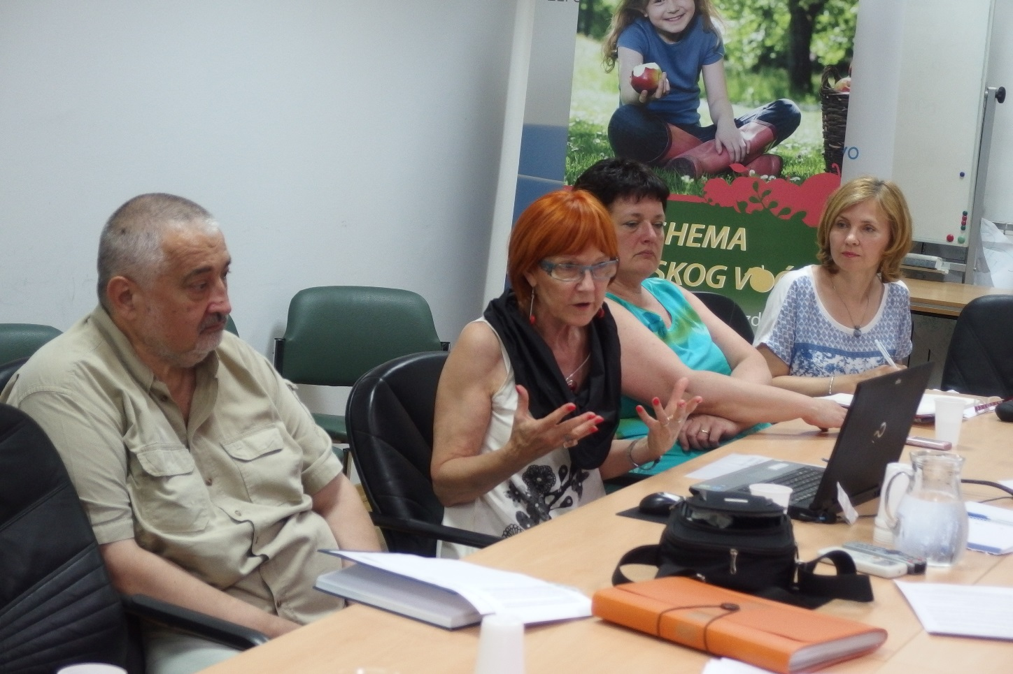
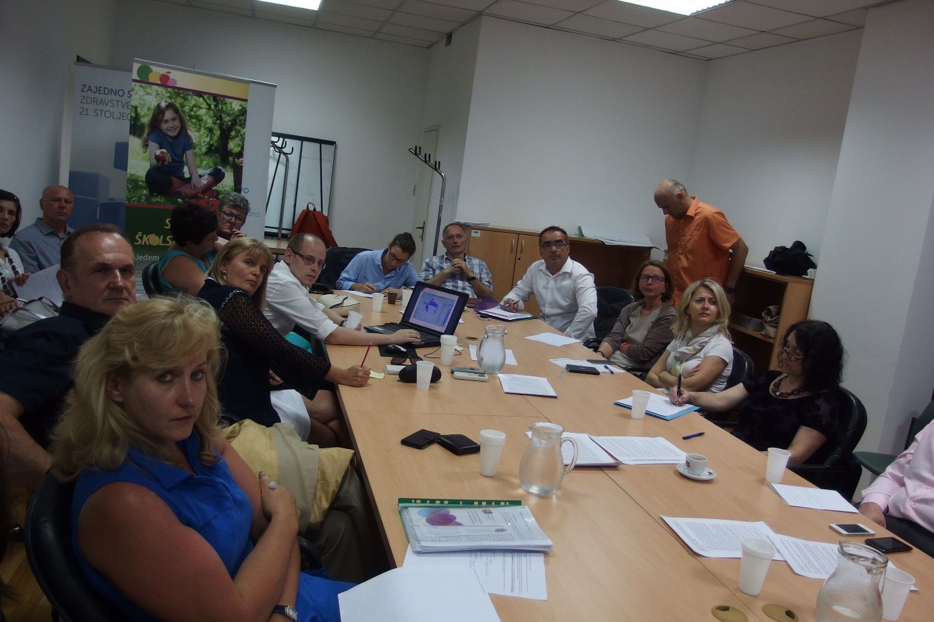
Round tables with stackeholders

Slide 7
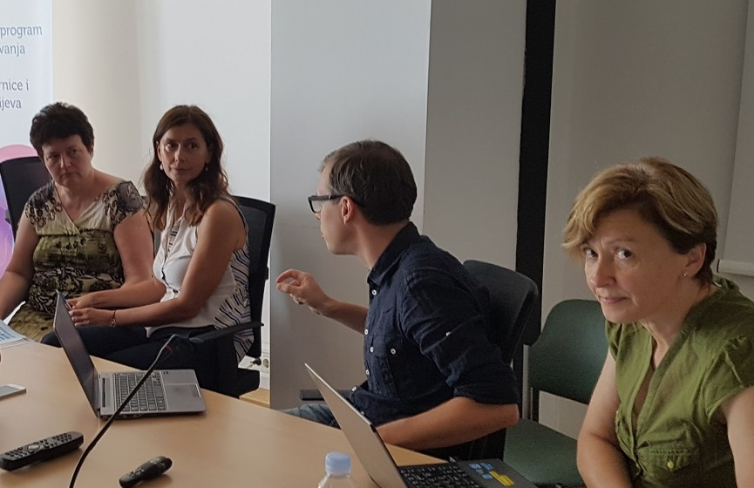
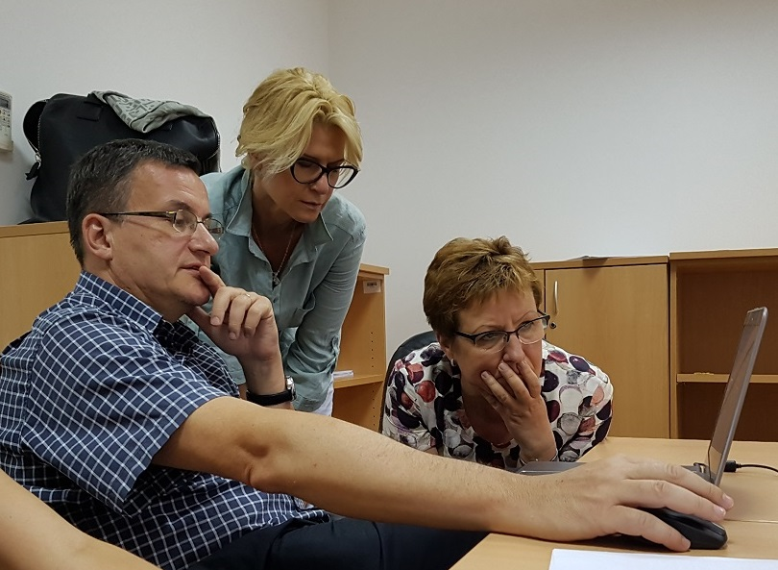
Work on NSP guidelines

Slide 8
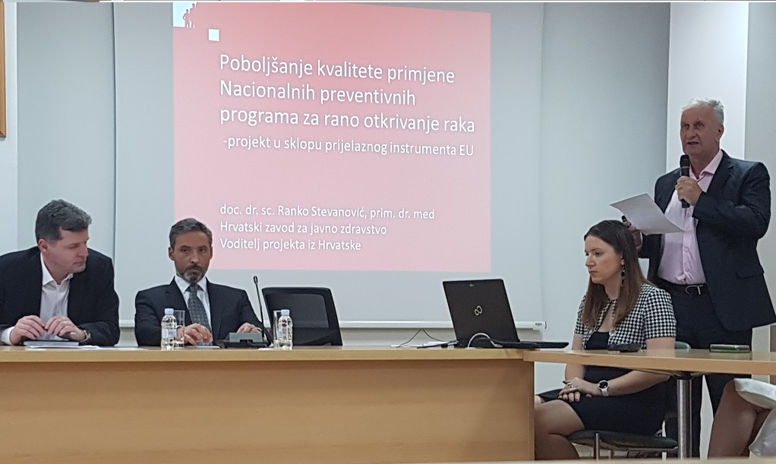
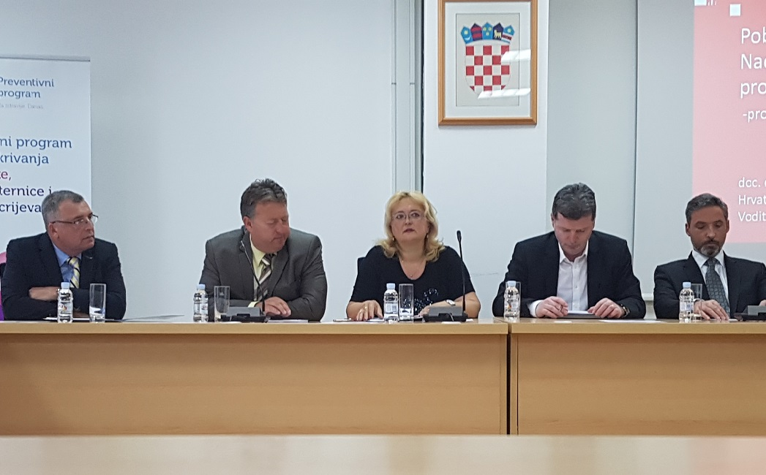
Initiation of Parlamentary declaration against cancer

Slide 9
2 quarter missions
  1.2; 2.2 and 3.2 Missions (7-10 June 2016);
  5.5 Mission (27 June – 1 July 2016);
  1.3; 2.3 and 3.3 Missions (28 June – 1 July 2016);
  1.4; 2.4 and 3.4 Missions (4-8 July 2016).

Slide 10
Achievement of mandatory results
Component 1: Organization and implementation of the National Breast Cancer Screening Programme on national and regional level improved
Activity 1.2
Conducting analysis of practices applied and corresponding documentation related to organization and implementation of the National Breast Cancer Screening Programme and preparing analysis report with recommendations for improvement. | 100 % fulfilled | Completed. Analysis of practices applied and corresponding documentation related to organization and implementation of the National Breast Cancer Screening Programme conducted and analysis report with recommendations for improvement prepared.
Results and indicators | (% of achievement) |  | State of achievement/ problems encountered

Slide 11
Achievement of mandatory results
Component 1: Organization and implementation of the National Breast Cancer Screening Programme on national and regional level improved
Activity 1.3
1 round table discussion of the representatives of Ministry of Health, CIPH, County Institutes of Public Health and other relevant stakeholders on organization and implementation of the National Breast Cancer Screening Programme organizes and conducted. | 100 % fulfilled | Completed. 1 round table discussion of the representatives of Ministry of Health, CIPH, County Institutes of Public Health and other relevant stakeholders on organization and implementation of the National Breast Cancer Screening Programme organized and conducted.
Results and indicators | (% of achievement) |  | State of achievement/ problems encountered

Slide 12
Achievement of mandatory results
Component 1: Organization and implementation of the National Breast Cancer Screening Programme on national and regional level improved
Activity 1.4
Guidelines for the National Breast Cancer Screening Programme prepared and adopted by the relevant authority (e.g. National Committee and/or Ministry of Health) | 100 % fulfilled | Completed. Guidelines for the National Breast Cancer Screening Programme prepared and adopted by the relevant authority (e.g. National Committee and/or Ministry of Health).
Results and indicators | (% of achievement) |  | State of achievement/ problems encountered

Slide 13
Achievement of mandatory results
Component 2: Organization and implementation of the National Cervical Cancer Screening Programme on national and regional level improved
Activity 2.2
Analysis of practices applied and corresponding documentation related to organization and implementation of the National Cervical Cancer Screening Programme conducted and analysis report with recommendations for improvement prepared. | 100 % fulfilled | Completed. Analysis of practices applied and corresponding documentation related to organization and implementation of the National Cervical Cancer Screening Programme conducted and analysis report with recommendations for improvement prepared.
Results and indicators | (% of achievement) |  | State of achievement/ problems encountered

Slide 14
Achievement of mandatory results
Component 2: Organization and implementation of the National Cervical Cancer Screening Programme on national and regional level improved
Activity 2.3
Analysis of practices applied and corresponding documentation related to organization and implementation of the National Cervical Cancer Screening Programme conducted and analysis report with recommendations for improvement prepared. | 100 % fulfilled | Completed. Analysis of practices applied and corresponding documentation related to organization and implementation of the National Cervical Cancer Screening Programme conducted and analysis report with recommendations for improvement prepared.
Results and indicators | (% of achievement) |  | State of achievement/ problems encountered

Slide 15
Achievement of mandatory results
Component 2: Organization and implementation of the National Cervical Cancer Screening Programme on national and regional level improved
Activity 2.4
Guidelines for the National Cervical Cancer Screening Programme prepared and adopted by the relevant authority (e.g. National Committee and/or Ministry of Health) | 100 % fulfilled | Completed. Guidelines for the National Cervical Cancer Screening Programme prepared and adopted by the relevant authority (e.g. National Committee and/or Ministry of Health).
Results and indicators | (% of achievement) |  | State of achievement/ problems encountered

Slide 16
Achievement of mandatory results
Component 3: Organization and implementation of the National Colorectal Cancer Screening Programme on national and regional level improved
Activity 3.2
Analysis of practices applied and corresponding documentation related to organization and implementation of the National Colorectal Cancer Screening Programme conducted and analysis report with recommendations for improvement prepared | 100 % fulfilled | Completed. Analysis of practices applied and corresponding documentation related to organization and implementation of the National Colorectal Cancer Screening Programme conducted and analysis report with recommendations for improvement prepared.
Results and indicators | (% of achievement) |  | State of achievement/ problems encountered

Slide 17
Achievement of mandatory results
Component 3: Organization and implementation of the National Colorectal Cancer Screening Programme on national and regional level improved
Activity 3.3
1 round table discussion of the representatives of Ministry of Health, CIPH, County Institutes of Public Health and other relevant stakeholders on organization and implementation of the National Colorectal Cancer Screening Programme organized and conducted | 100 % fulfilled | Completed. 1 round table discussion of the representatives of Ministry of Health, CIPH, County Institutes of Public Health and other relevant stakeholders on organization and implementation of the National Colorectal Cancer Screening Programme organized and conducted.
Results and indicators | (% of achievement) |  | State of achievement/ problems encountered

Slide 18
Achievement of mandatory results
Component 3: Organization and implementation of the National Colorectal Cancer Screening Programme on national and regional level improved
Activity 3.4
Guidelines for the National Colorectal Cancer Screening Programme prepared and adopted by the relevant authority (e.g. National Committee and/or Ministry of Health) | 100 % fulfilled | Completed. Guidelines for the National Colorectal Cancer Screening Programme prepared and adopted by the relevant authority (e.g. National Committee and/or Ministry of Health).
Results and indicators | (% of achievement) |  | State of achievement/ problems encountered

Slide 19
Achievement of mandatory results
Component 5: Monitoring and reporting of the National Cancer Screening Programmes on national and regional level improved.
Activity 5.5
Screening Register upgraded | 20 % fulfilled | Ongoing. The documentation for public procurement prepared and procurement procedures for the registry upgrade has been finalised. Contract has been signed. Plan for upgrade prepared (One mission implemented). Upgrade is ongoing.
Results and indicators | (% of achievement) |  | State of achievement/ problems encountered

Slide 20
Adherence to time schedule
Activities | Months
 | June | July | August | September | October | November
0.1
0.2
1.1
1.2
1.3
1.4
2.1
2.2
2.3
2.4
3.1
3.2
3.3
3.4
4.1
4.2
4.3
4.4
4.5
4.6
4.7
5.1
5.2
5.3
5.4
5.5

Slide 21
Future activities
3 quarter:
  4.1 Mission (29 August– 2 Sept, 2016);
  5.1 Mission (5-9 Sept, 2016);
  4.6 Mission (19-23 Sept, 2016);
  4.2 Mission (3-7 Oct, 2016);
  5.2 Mission (10-14 Oct, 2016);
  4.4 Mission (24-28 Oct, 2016);
  5.3 Mission (7-11 and 14-18 Nov, 2016);
  4.7 Mission (23-25 Nov, 2016)
  Total: 33 Missions, 157 expert days

Slide 22
Future activities
4 quarter:
Regional trainings Act 4.3
    January 18-25 (Zagreb-Split)
    February 1-8 (Rijeka-Osijek)
  Regional trainings Act 4.5
    February 15-22 (Zagreb-Split)
    March 8-15 (Rijeka-Osijek)
  Activity 5.5 in March 20-24, 2017
  Total: 13 Missions, 77 expert days

Slide 23
Overall assessment of progress
22 STE missions, total 98 working days.
Up to date we are fully implemented 1-2-3 components. Started our activities in 4&5 components.
  Progress: 54% of project mandatory results (13 out of 24 mandatory results).
  Total amount of working days 174,5 out of 409 planned in total, it is 43% of all working days planned.
1 Addendum, 1 Side Letters and 1 Operative Side letter have been issued.
Good and efficient collaboration with HZJZ and MoH staff in preparation of STE missions and round table;
Added value: as a result of previous missions, we initiated the Parlamentary Declaration on improvement of Cancer care;
Aiming to be achieved 80% of project mandatory results until end of 3rd quater.

Slide 24
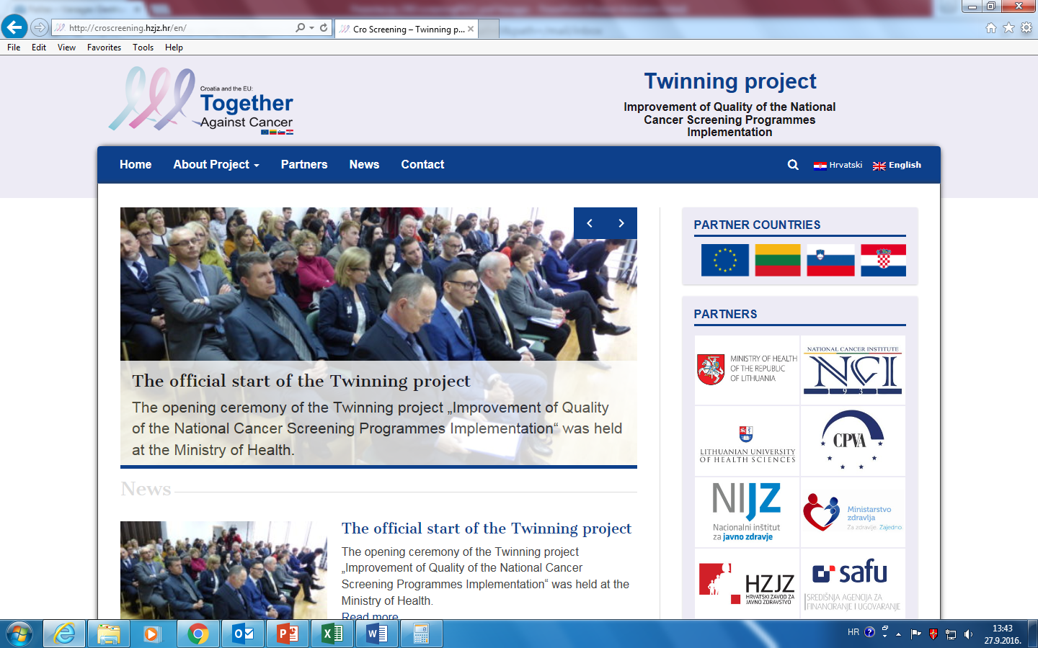
Visibility
The project webpage has been launched and updated. The webpage aims to disseminate information and news from project activities. Web page can be accessed on: http://croscreening.hzjz.hr/

Slide 25
Issues and problems
The BC PL has been changed. Ms. Dinka Nakić took this responsibility over Mr. Ranko Stevanović. The management of the project goes smoothly. In general, the cooperation between Partners since the beginning of the project has been efficient.
Summer time (and the vacation period) made it impossible to implement expert missions during that period. According to this we had to adjust our activity plan.
The 1st activity report has been submitted to CFCA on 13 June, 2016. Up to date no comments has been received, report requires to be approved.

Slide 26
Risk management issues
Risk | Management actions should be taken
Availability of the BC and MS experts is not ensured. | The planing of mission dates in advance (2-3 monts before mission). BC and MS PL should be taking responsibility to ensure availability of experts.
Relevant stakeholders do not succeed to ensure the active participation in the planned activities; | The planning of mission dates in advance should ensure timely invitations and replacements if necessary.
Adequate experts are not available for the trainings and workshops; | Invitations and information to the participants has to be sent far in advance. We already asked BC to prepare lists of participants and define target groups for trainings in component 4.

Slide 27
Next PSC meeting
Date proposal:
21 December 2016

Slide 28
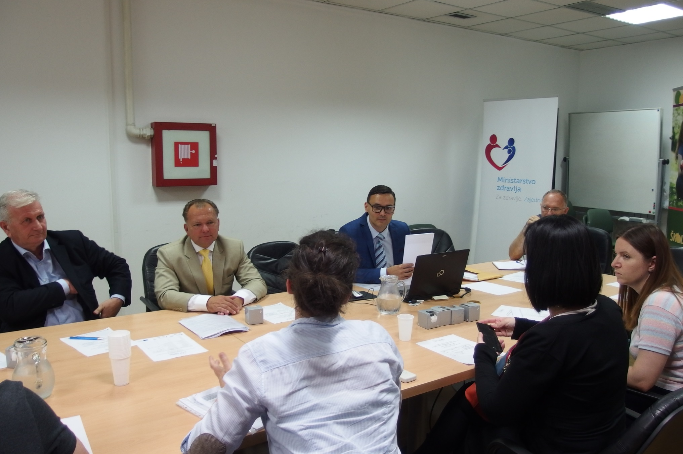
Some moments from 1 PSC

Slide 29
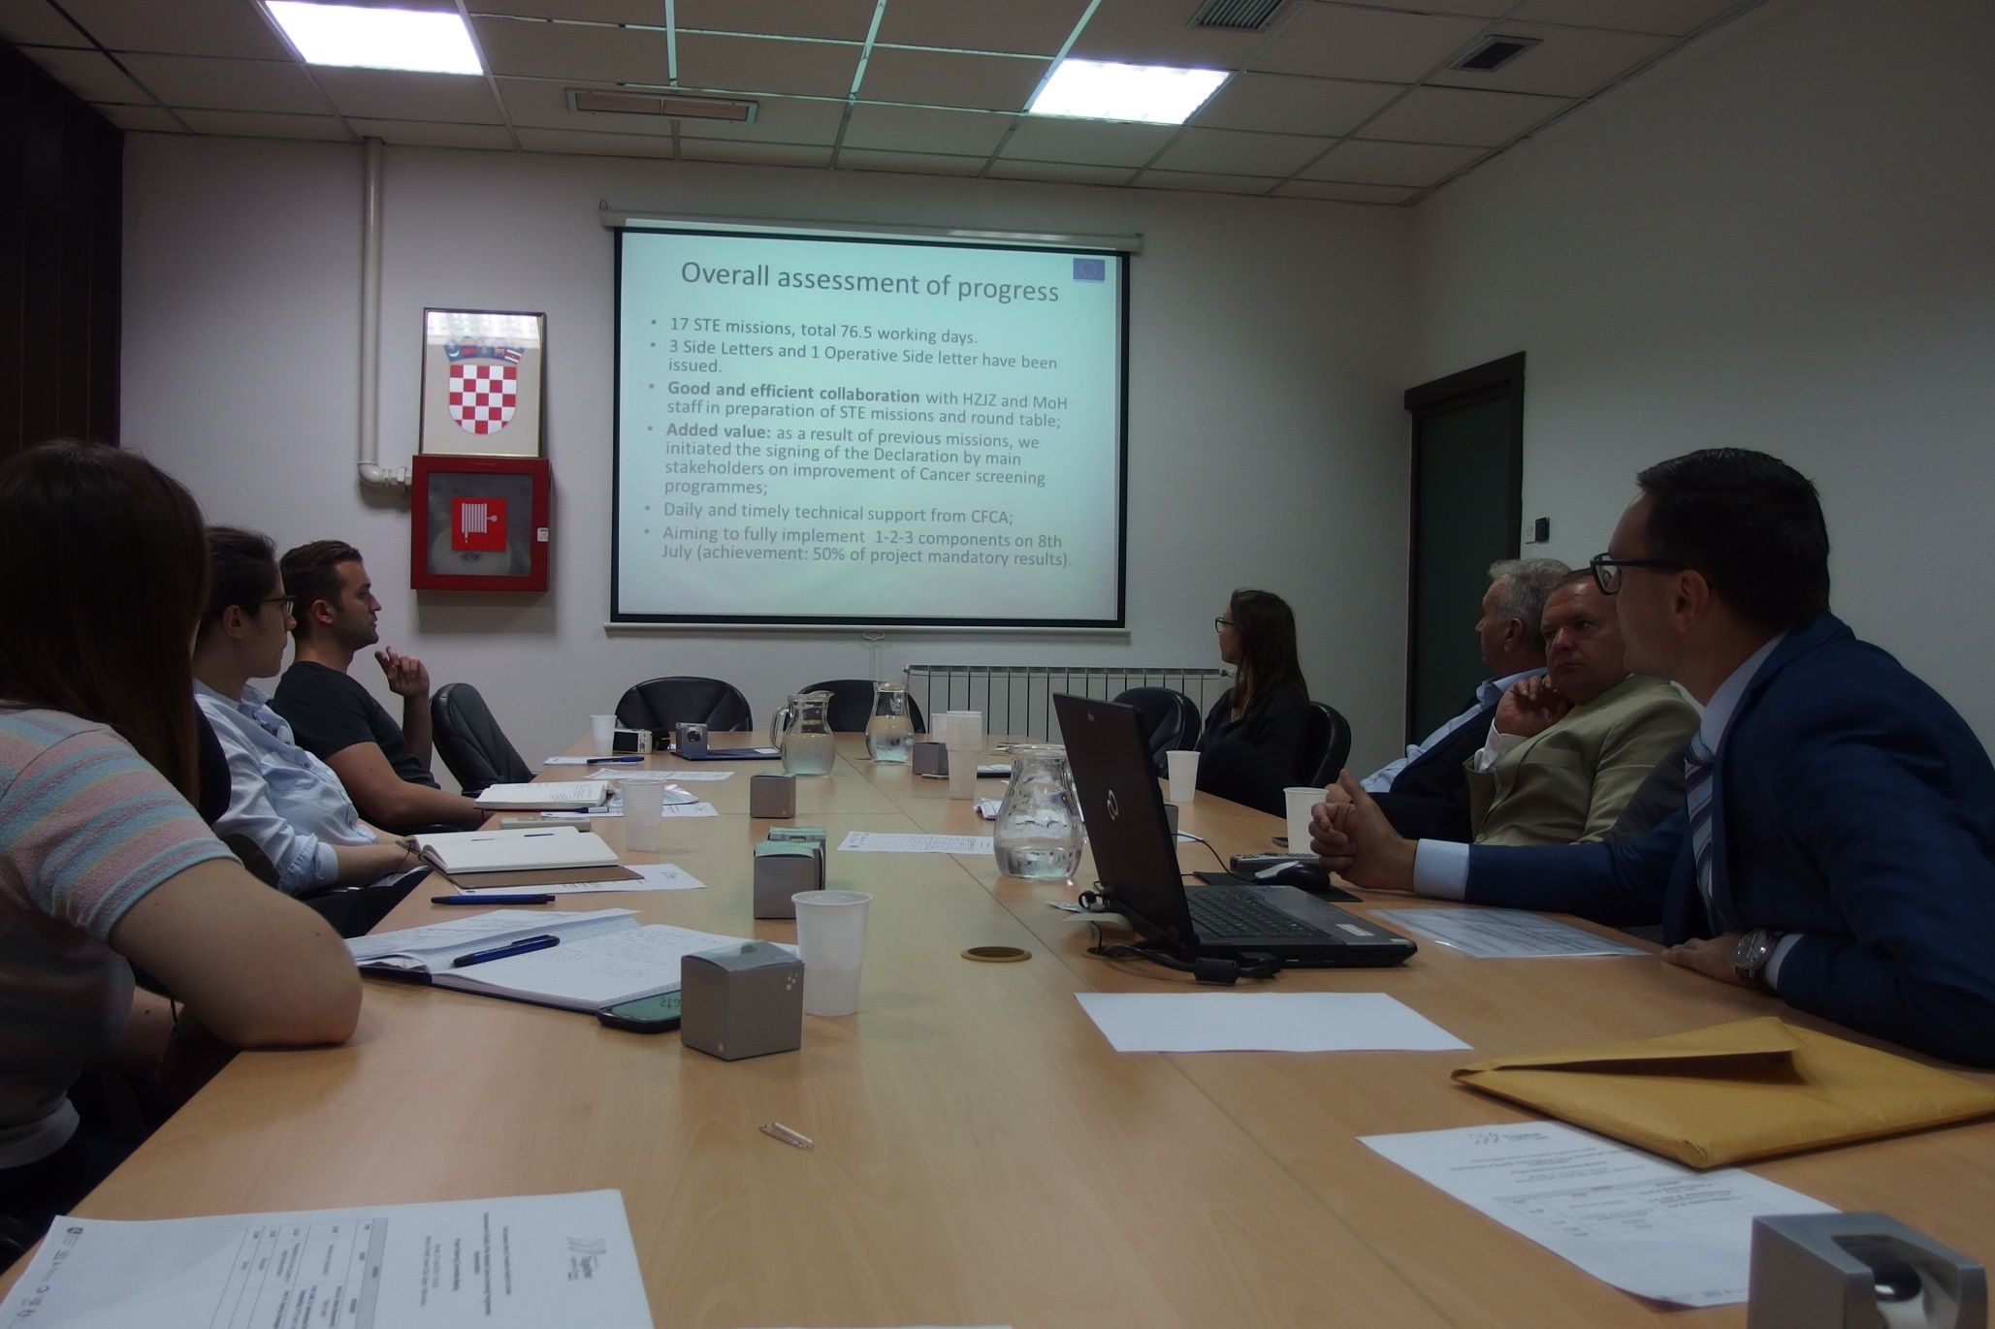
Some moments from 1 PSC

Slide 30

Resident Twinning Adviser (RTA):
Prof. Giedrius Vanagas (LUHS)
T. +385-1-4863371 mob. +385-95-7309806 giedrius.vanagas@hzjz.hr

