Slide 1


Slide 2
Quality Indicators for Colonoscopy
Dr. Kęstutis Adamonis, Dr. Romanas Zykus,
2017 02 15 – 22
2017 03 09 – 15

Slide 3
Colonoscopy
The invention of the colonoscope has revolutionized the way we evaluate luminal diseases of the colon.
With colorectal cancer being the third most commonly diagnosed cancer as well as the third most frequent cause of cancer-related mortality in both men and women, colonoscopy offers an advantage of detecting cancer and the ability to remove precancerous lesions.
As a result of its effectiveness in the detection and prevention of colorectal neoplasms, colonoscopy has become the screening test of choice for many gastroenterologists and patients

Slide 4
Quality Indicators for Colonoscopy
Although the ideal quality measure for colonoscopy is not unequivocally established, there are several proven quality indicators.
With most of the problems of colonoscopy resulting from operator-dependent factors, it is no longer acceptable not to measure colonoscopy quality.
The judicious use of quality metrics should allow identifying marginal performers and implementing educational initiatives to correct their performance to provide the best care possible to our patients.

Slide 5
Quality Indicators for Colonoscopy
Why is this important?
  To maximize cost-effectiveness of CRC screening with colonoscopy
  The purpose of colonoscopy is to reduce CRC and improved quality shouldreduce post-colonoscopy or “missed”CRC.
  To minimize risks to patients

Slide 6
Quality assurance item | Proposed standard
Consent and withdrawal of consent | Audit the number of patients who decline colonoscopy on the day of the procedure and the number of intraprocedural withdrawals of consent. Proposed standard: fewer than 5% of cases to withdraw consent on the day of the procedure and fewer than 1% during the procedure.
Experience of the screening colonoscopist | We recommend that a minimum lifetime colonoscopy experience together with a minimum number of annual screening colonoscopies should be agreed. Proposed standard: to be agreed by screening boards
Bowel cleansing | The state of bowel cleansing should be audited. Proposed standard: at least 90% of examinations should be rated as “adequate” bowel cleansing or better
Sedation, analgesia, and comfort | Audit of sedation practices, including average doses used of medication together with comfort scores. Proposed standard: no more than 1% of patients should become hypoxic (saturation below 85% for more than 30 seconds) or for other reasons require administration of a reversal agent
Unadjusted cecal intubation rate | Audit the completion rate for all colonoscopies. Proposed standard: unadjusted cecal intubation rate of at least 90%
Adenoma and cancer detection rates | The number of detected adenomas and cancers should be audited. Proposed standard: to be agreed by screening boards
Colonoscope withdrawal time | Average withdrawal times should be audited. Proposed standard: a minimum of 6 minutes in at least 90% of purely diagnostic examinations
Polyp retrieval rate | Screening programs anticipate that all resected polyps are retrieved for histological analysis. Proposed standard: ≥ 90% of resected polyps should be retrieved for histological analysis
Significant interval lesions | We recommend that screening programs monitor size, appearance, location, and histology of all polyps larger than 1 cm and cancers found between screening examinations as well as after the patient has been discharged from a screening program. Proposed standard: to be agreed by screening boards

Slide 7
Quality assurance item | Proposed standard
Specialist referral for removal of larger polyps | We anticipate that the removal of larger polyps will be deferred to a dedicated clinical session, perhaps at a separate tertiary referral centre. Screening programs should record how larger polyps detected at screening are managed, together with details of outcomes. Proposed standard: to be agreed by screening boards
Cleaning and disinfection | Adoption of manufacturers’, national, and European standards for disinfection. Proposed standard: routine microbiological testing at intervals not exceeding 3 months
Tattooing sites of larger polyps and cancers | We recommend that screening programs set standards regarding which polyp sites should be tattooed. Proposed standard: the placement of tattoos following the removal of all polyps 2 cm or larger outside of fixed colonic landmarks such as the cecum and rectum
Unscheduled readmissions | We recommend that screening programs record details of all emergency admissions within 30 days of the screening colonoscopy. Proposed standard: to be agreed by screening boards
Perforation rate | We recommend that details should be recorded of all perforations complicating diagnostic and therapeutic procedures, that require surgical repair and that occur up to 2 weeks after endoscopy. Proposed standard: fewer than 1:1000 diagnostic or therapeutic examinations should result in a perforation requiring surgical repair
Bleeding rate | All cases of immediate and late bleeding following polypectomy should be recorded. Proposed standard: fewer than 1:20 cases of bleeding should ultimately require surgical intervention

Slide 8
Most important QIC indicators
Adenoma detection rate
Cecal intubation rate
Endoscopic complication rate
Colonoscopist patient load
Quality of colonoscopy preparation
Colonoscope withdrawal time
Left and right colon adenoma detection proportion
Mean adenomas per procedure
Sessile serrated lesion in right colon detection rate
Referral to surgery or tertiary endoscopy in the same or another center

Slide 9
Adenoma detection rate
Adenoma detection rate(ADR), the primary quality indicator or outcome for an endoscopist, can be viewed as a function of the other quality measures. These include cecal intubation rates, withdrawal times, and quality of bowel preparations.

Slide 10
Performance of endoscopists
It is recommended that the annual number of procedures performed by an endoscopist is recorded to ensure that the sample size for key performance indicators is sufficient
Each endoscopist participating in a colorectal cancer screening programme should undertake to perform at least 300 procedures per year to ensure there is a sufficient sample size to assess competence. A higher volume of procedures is desirable
Services should be planned such that individual endoscopists achieve a desirable volume of procedures (>300/ year)

Slide 11
Bowel preparation quality
Another quality measure that affects adenoma detection is the quality of the bowel preparation.
An adequate colon preparation is vital to ensure complete mucosal inspection. It has been reported that only three quarter of colonoscopies have an adequate colon preparation.
High rates of missed adenomas and advanced neoplasia have been observed in patients with suboptimal colon preparations.

Slide 12
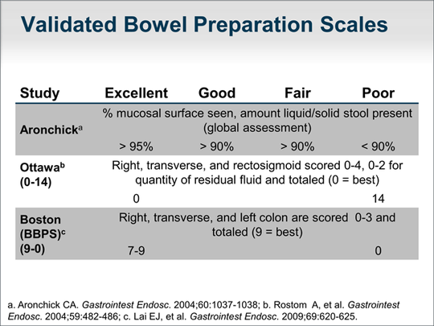
Boston bowel preparation score is the most popular validated score

Slide 13
Representative photos of bowel segments scored using the Boston Bowel Preparation Scale
(a) Segment score 0: unprepared colon segment with the visibility of the mucosa obscured by solid stool material that cannot be cleared.
(b) Segment score 1: poorly prepared colon segment in which only limited portions of mucosa can be seen, while other areas of the colon segment are obscured by staining, residual stool, and/or opaque liquid.
(c) Segment score 2: minor amount of residual staining, small fragments of stool and/or opaque liquid that are sufficiently reduced as to allow the mucosa of the colon segment to be seen.
(d) Segment score 3: a colon segment in which the entire mucosa can be seen well with no residual staining, small fragments of stool, or opaque liquid.

Slide 14
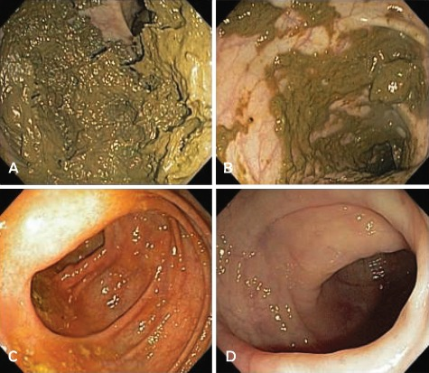

Slide 15
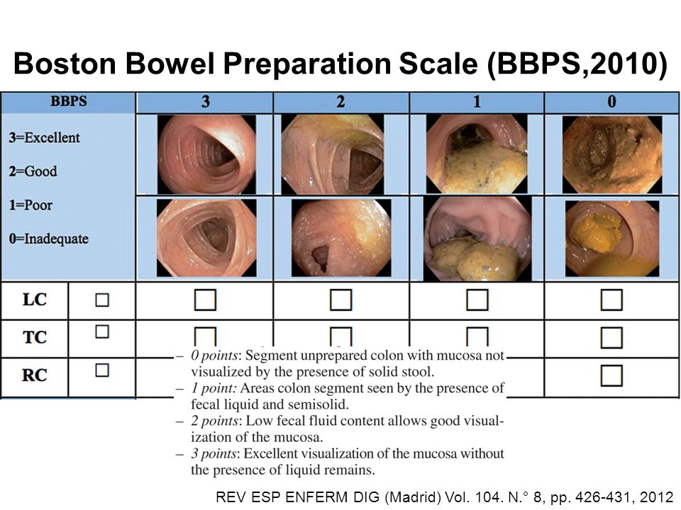

Slide 16
Bowel Preparation is Adequate:
90% of Outpatient Procedures
Frequency of inadequate bowel preparation that requires repeat colonoscopy within 1 year should be < 10%.
If this goal isn’t met, then bowel preparation protocols, including patient education, choice of purgative, and protocol for administering the purgative, including use of the split-dose protocol, should be re-examined.
Goal: Minimize need to repeat colonoscopy.

Slide 17
Bowel Preparation is Adequate:
90% of Outpatient Procedures
What interventions may minimize inadequate bowel preps:
Institute split-bowel preparation. Ingesting the 2nd half of bowel preparation 6 hours prior to colonoscopy is optimal
Use more aggressive bowel preparation regimens for patients at high risk for inadequate preparation (e.g., history of constipation, diabetic, opiod-use, history of poor bowel prep in the past).

Slide 18
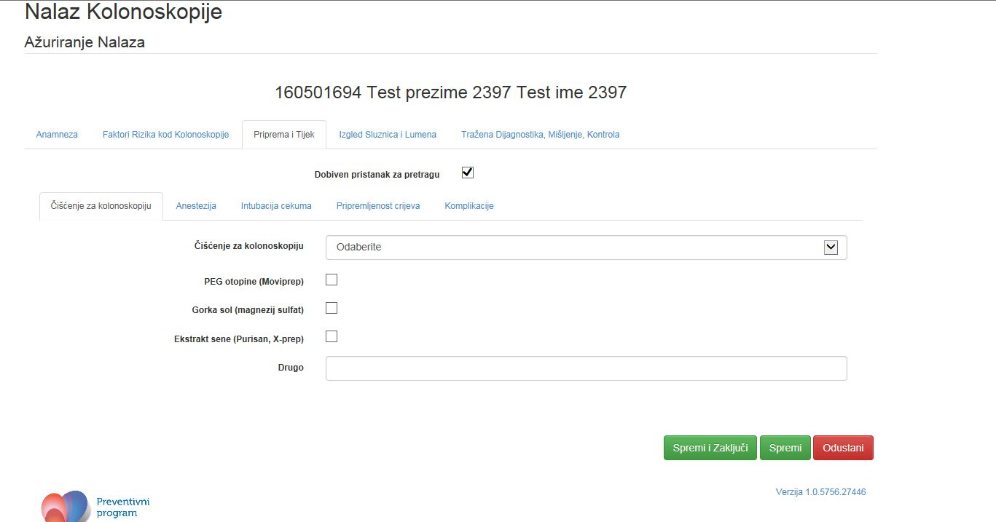

Slide 19
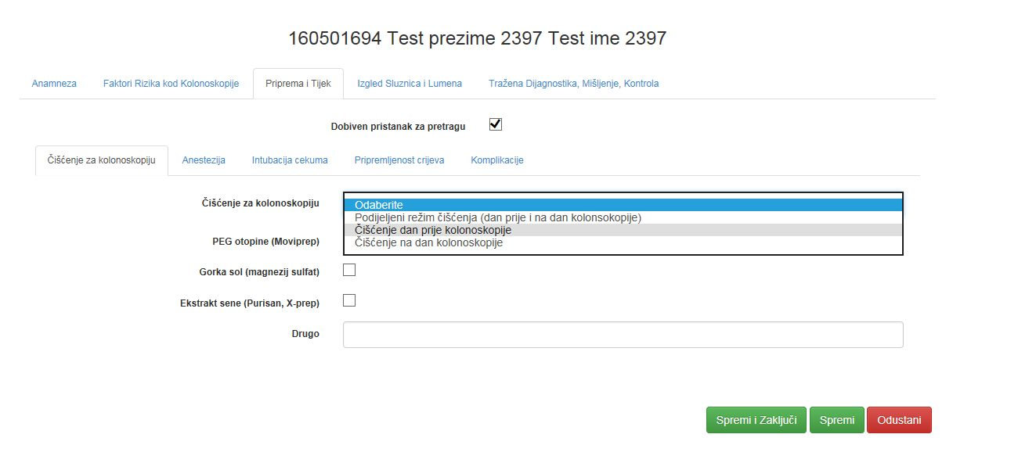

Slide 20
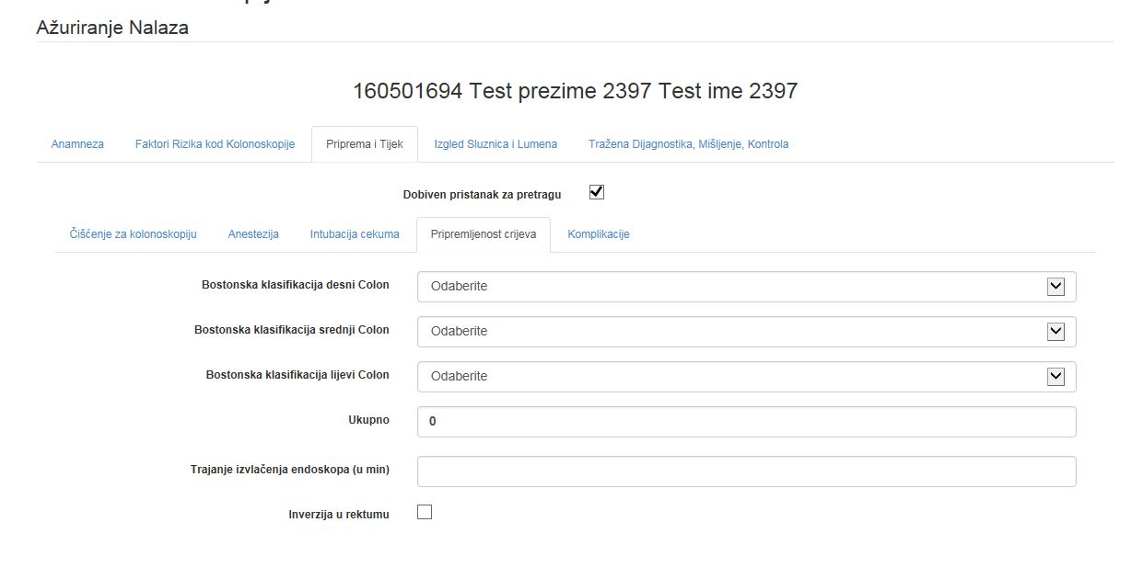

Slide 21
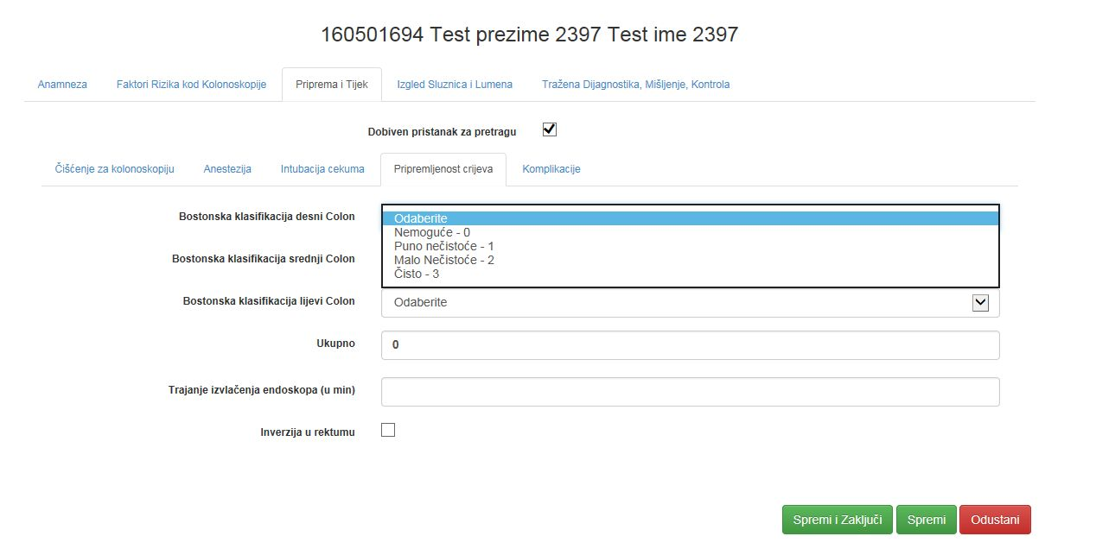

Slide 22
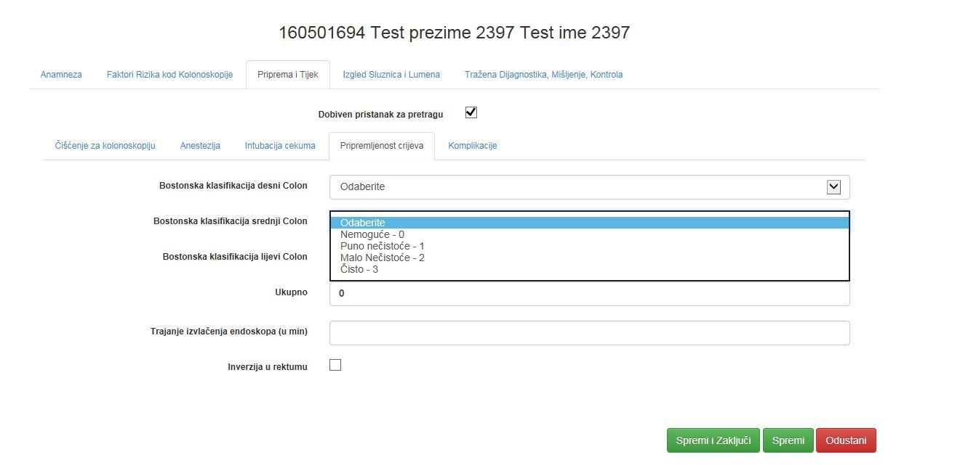

Slide 23
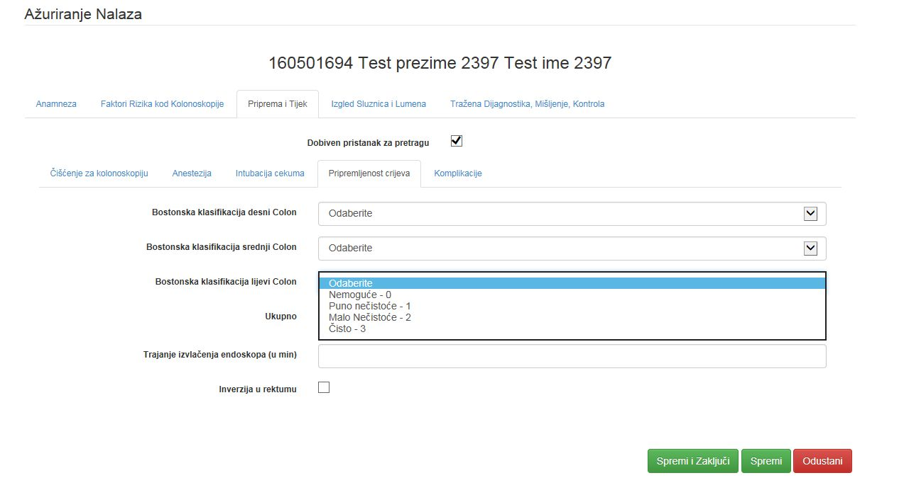

Slide 24
Colonoscope withdrawal time
To maximize adenoma detection, adequate mucosal inspection is required to ensure complete examination
Withdrawal time, the time measured from when the colonoscope reaches the cecum to the time the scope is withdrawn from the anus in the absence of polyp removal, has also been studied as a quality metric in colonoscopy.

Slide 25
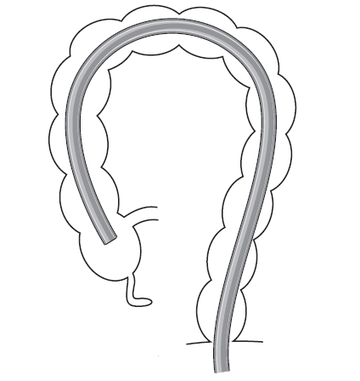

Slide 26
Colonoscope withdrawal time
Studies have demonstrated that a withdrawal time of ≥6 min or more increased the detection of neoplastic lesions during colonoscopy in patients with intact colons.
The investigators observed that compared with endoscopists who had mean withdrawal times of 6 min or longer, those who had a shorter withdrawal time had lower detection rates of any adenoma as well as advanced adenomas.

Slide 27
Colonoscope withdrawal time
Longer withdrawal time was recently reported to be associated with
  higher proximal serrated polyp detection rate (PSP-DR)
  significant increase of the ADR.
Withdrawal time could have a role for endoscopists not meeting targets for ADR, PR, and PSP-DR.
Recommendation - its use in instances of low ADR.

Slide 28
Retrieval of polyps
The risk of polyp-cancer increases with the size of the polyp
In the UK pilot demonstration of colorectal screening, 16.6% of all cancers were “polyp cancers”
In organized screening programs it is expected that resected polyps will be retrieved for histological analysis
Successful retrieval of at least 90% of excised polypsseems a reasonable standard

Slide 29
Proximal Serrated Polyp Detection Rate
Proximal serrated polyp detection rate (PSP-DR) is defined as the proportion of patients undergoing screening colonoscopy in whom at least one serrated polyp (hyperplastic polyp, sessile serrated adenoma/polyp, traditional serrated adenoma) is identified proximal to the splenic flexure.
Interest in the PSP-DR has been rising in relation to the concerns about the limited protective effect of colonoscopy in the right colon and the emerging appreciation of the role of the serrated pathway in colorectal neoplasia.
Potential contributing factors are :
  the more subtle endoscopic features of serrated polyps
  and the lower quality of bowel preparation in the right colon, particularly without split dosing.

Slide 30
Proximal Serrated Polyp Detection Rate
The strong correlation between ADR and PSP-DR suggests that PSP-DR can be considered a valid measure of quality for colonoscopy.
However, the strong correlation also implies redundancy between ADR and PSP-DR.
There are other obstacles to the PSP-DR becoming an independent quality metric.
The current targets for ADR have been shown to correspond to PSP-DR of 4.5% for both men and women, with a suggested benchmark of 5%.
The ADR can be used as surrogate for both adenomatous and serrated polyps, but high-level adenoma detectors who are motivated to obtain a comprehensive assessment of quality can consider measuring PSP-DR as a complementary quality metric

Slide 31
The mean number of adenomas per colonoscopy
Adenoma detection rate (ADR) is most commonly recommended neoplasia – related quality indicator.
However, the mean number of adenomas (MNA) per colonoscopy is better reflection full length of colon examination and “could prove“ to be the ideal measure of adenoma detection.
Assesses the ability of endoscopists in detecting multiple adenomas per patient.
MNA is sensitive to changes in bowel preparation with higher MNA among those with good bowel preparation compared with those with poor preparation.

Slide 32
Left and right colon adenoma detection proportion
Share of adenomas detected in left/ right colon among all adenomas detected in entire colon.
Right hemicolon includes flexura lienalis, colon transversum flexura hepatica, colon ascendens, and cecum.
Left hemicolon includes anus, rectum, colon sigmoideum and colon descendens.

Slide 33
Referral to surgery or tertiary endoscopy in the same or another center
Share of people referred to surgery or additional colonoscopy for polypectomy among number of people with findings at colonoscopy
It is recommended that screening programs audit how larger lesions detected at screening are managed, together with details of outcomes (In particular, the number of benign lesions referred for surgical resection should be recorded and outcomes monitored)
There is evidence from the French screening program that up to 10% of entirely benign polyps are removed surgically rather than endoscopically.

Slide 34
**What Are the Quality Indicators?
Quality Indicators that should be met in > 98% of colonoscopies:
Informed consent is documented.
Quality of bowel preparation is reported.
Withdrawal time is measured and reported.
Endoscopic removal of pedunculated polyps and large (< 2cm) sessile polyps should be attempted before surgical referral.

Slide 35
**What Are the Quality Indicators?
Documented Appropriate Indication for Colonoscopy: > 80%
Bowel preparation is adequate: 90%
Cecal intubation: >95%
Average withdrawal time in negative screening colonoscopies: >6 minutes

Slide 36
Workshop: Quality indicators for colonoscopy
You are the leader of Hospital endoscopy staff. You got the report from “National Committee for organization, expert monitoring, evaluation and quality control of the National colorectal cancer screening programme” indicating that the average quantity of interval cancers is higher than in other hospitals.

Slide 37
Discussion
What group of indicators should be checked for the reason of failure?
What results could show all these indicators?
Why quality of colonoscopy indicators are important to staff leader and witch of these indicators should be check first?
At what level and cross-section all these indicators should be checked, why? (staff in general, separate colonoscopist)
Who is responsible for input of the data required for these indicators?
Is there any problem to monitor these indicators in Croatia? (At doctor, staff, hospital, county and country level).
Who is most interested in gathering this data (medical workers, public health specialist, government or health system insurance?)
What materials and resources are needed to monitor all these indicators and to improve its collection?

